Slide 1
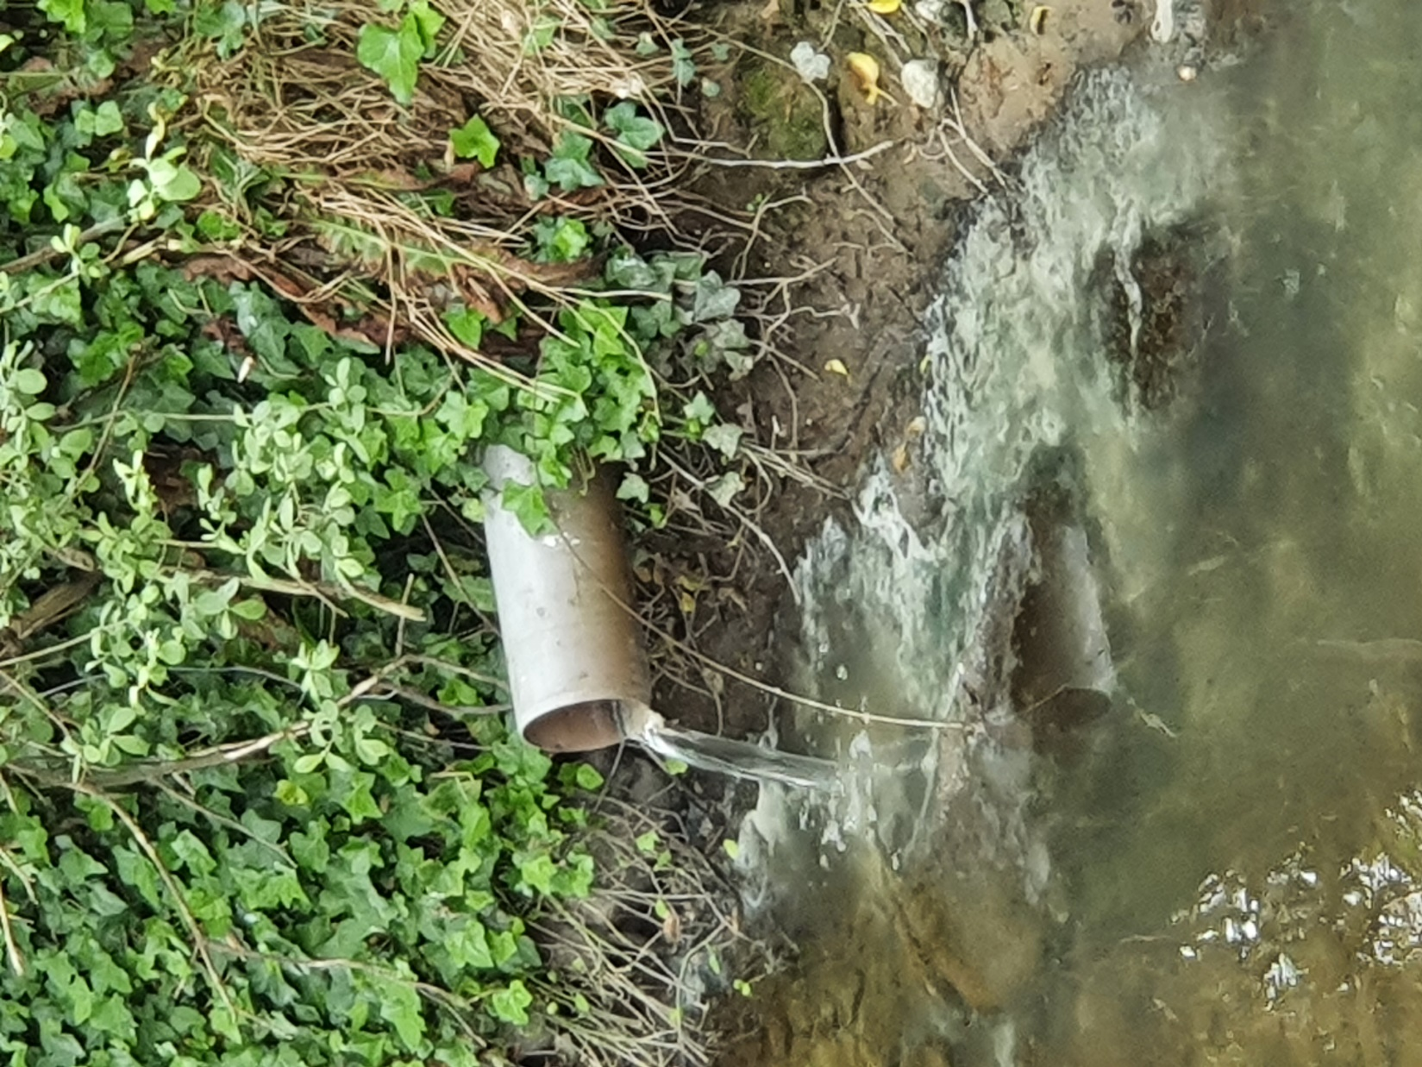
Water Quality & Pollution Lesson 5. Reporting Water Pollution
Notes:
Ask students what would they do if they saw water pollution
What would they do if they say it?

Slide 2
Water Pollution
In Ireland major pollution and fish kill incidents have declined over the past 20 years
BUT!
Localised pollution incidents still occur mainly due to:
Accidental spills
Poor waste management
Extreme weather events
Illegal activities
If you see water pollution you should report it to help prevent it becoming a worse incident.

Slide 3
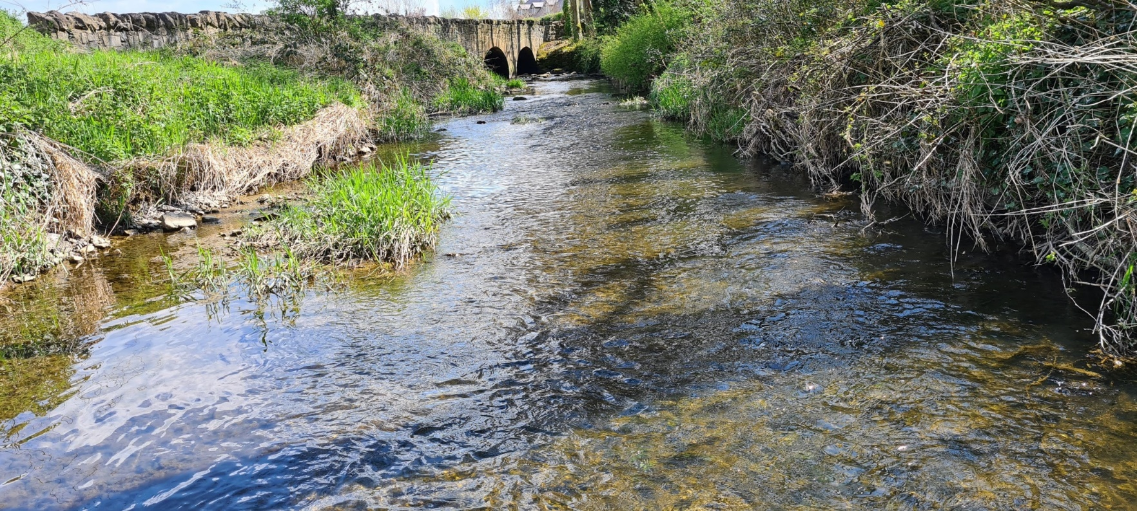
Reporting Water Pollution in Ireland
If you see pollution:
Take photographs – a zoomed out and zoomed in shot.
Note the location and time
Send the photos, the location details and time you saw the pollution to your local city or county council via email or website
Use See it Say it! app
Notes:
Photo source: Liz Gabbett, Maigue Rivers Trust

Slide 4
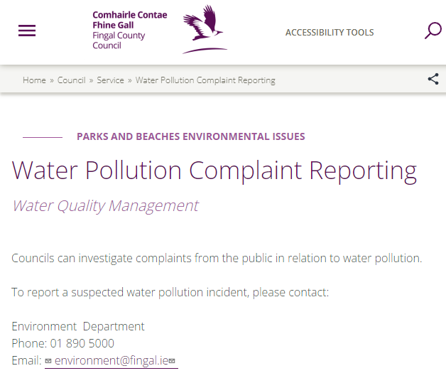
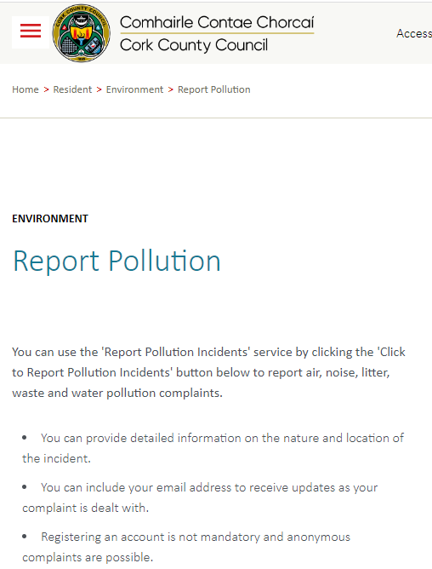
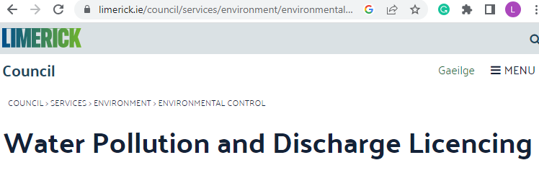
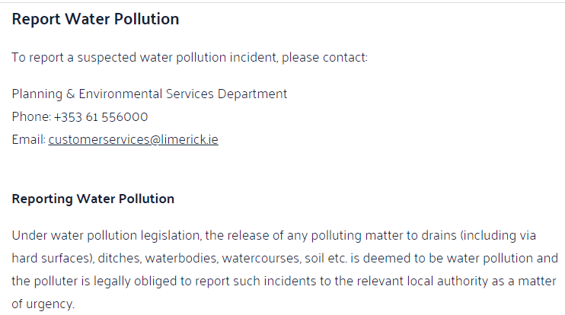
A sample of reporting instruction from councils.
Notes:
A sample of reporting instruction from councils
https://www.limerick.ie/council/services/environment/environmental-control/water-pollution-and-discharge-licencing#report
https://www.corkcoco.ie/en/resident/environment/report-pollution
https://www.fingal.ie/council/service/water-pollution-complaint-reporting
https://tipperarycoco.com/environment/water-pollution-complaint-reporting

Slide 5
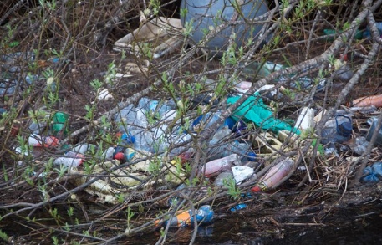
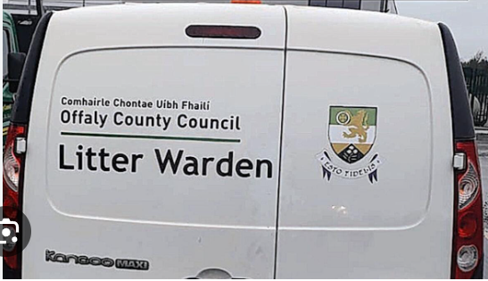
Council Investigation Responsibility
Local city and county councils investigate water pollution complaints from the public.
After a site inspection the Council staff then decide what other agencies may need to be informed, e.g.
Inland Fisheries Ireland
Environment Protection Agency
Uisce Éireann
National Parks and Wildlife Service
Gardai

Slide 6
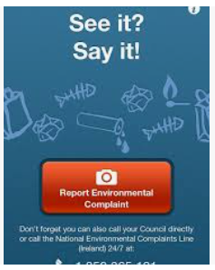
EPA – See it Say it
If your complaint is about an EPA regulated site, the council will pass on your complaint.
Call the National Environmental Complaints Line (NECL)
Tel: 1800 365 123, open 24-hours, 7-days per week.
Or you can:
Use the 'See It? Say It!' smartphone app
Apple iPhone: Download from the Apple App Store Android smartphone: Download from the Android Play Store

Slide 7
Water Quality Complaints
If you have a complaint about drinking water quality, you should contact Uisce Eireann 1800 278 278
Notes:
https://www.water.ie/help/water-quality/

Slide 8
Role Play – Pollution Incident
A pollution incident occurred in a local swimming spot.
You and your class are going to act out the court case, hear the consequences and decide should there be a conviction.
Task 5.1
Notes:
Image: https://unsplash.com/photos/vdXMSiX-n6M
Free to use under the Unsplash License
Teachers – print out the role play instruction, make edits as appropriate and ask the students to play the different roles

