Slide 1
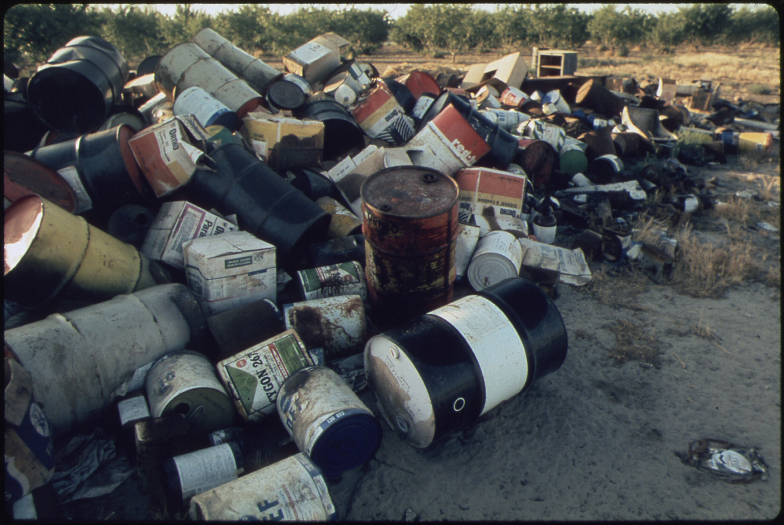
Water Quality and Pollution
Lesson 4. Toxic pollution in rivers and lakes

Slide 2
Toxic pollutants come in many forms:
Metals from mining and industry (mercury, cadmium, lead)
Pesticides from agriculture
Chemicals from industrial processes
Chemicals leaking from landfill sites
Accidental spillages
Microbial contamination
All of these can have a big impact, not only on aquatic life but on human use of water and human health.

Slide 3
Environmental pioneer
One of the most influential books ever written - Rachel Carson ‘s Silent Spring led to the birth of the environmental movement in the 1960s.
It is about the indiscriminate use of pesticides and their impact on the environment.
https://www.pbslearningmedia.org/resource/envh10.sci.life.eco.silentspring/rachel-carsons-silent-spring/ 4:48min
Notes:
Specifically, Silent Spring explained how indiscriminate application of agricultural chemicals, pesticides, and other modern chemicals polluted our streams, damaged bird and animal populations, and caused severe medical problems for humans.

Slide 4
Toxic Pollution
Toxic Pollutants damage or poison some vital system in the animal’s body; for example, cyanide, which prevents cell respiration resulting in paralysis and death.
Many toxic pollutants, such as pesticides, affect the nervous system. The environmental impact of some are well known, DDT was highlighted by Rachel Carson in her book Silent Spring which led to the birth of the environmental movement in the 1960s.
Others may damage immune systems, reproductive systems or cause cancer.
As impacts are not clear, following the precautionary principle, their use is highly regulated to avoid environmental and/or human health damage.
Yet, the EPA report herbicides have been detected in two-thirds of all rivers surveyed in Ireland

Slide 5
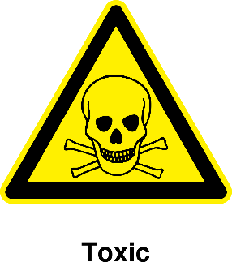
Toxic Pollution
Extreme care is needed when dealing with pesticides, as this report shows.
Even small amounts used in gardens needed to be used and disposed of properly.

Slide 6
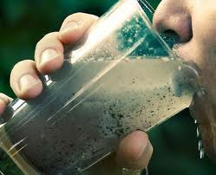
Microbial Pollution
Water in rivers and lakes contain multitudes of bacteria and other micro-organisms that are beneficial for the functioning of aquatic ecosystems.
However, water can carry harmful micro-organisms that don’t occur naturally in the water but get there from contamination. This is why we treat drinking water to reduce the risk of disease.
Most of the harmful micro-organisms are found naturally in gut of domestic and wild animals, and humans. They get into water when it’s contaminated by faeces and urine.

Slide 7
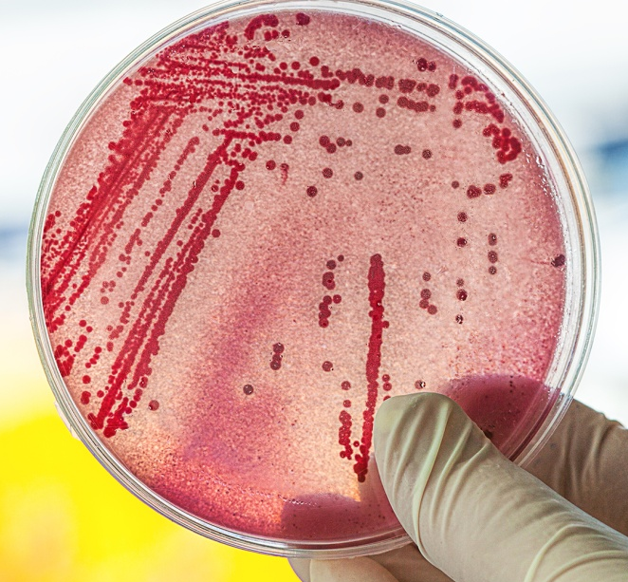
Microbial Pollution continued
E. coli – bacterium occurring naturally in gut of humans and other animals. Can be beneficial, but some strains are disease-causing. The VTEC strain can cause kidney failure.
Leptospira – found in wild rodents. Causes Weil’s Disease or Leptospirosis in humans.
Cryptosporidium
Parasite that lives in gut of livestock. Causes diarrhoea and fever in humans.
Ireland has highest incidence of illness in EU; higher stocking rates of livestock - more animal waste is getting into rivers and lakes that supply drinking water. Very serious public water issue in Galway 2007.
Is resistant to chlorination, so treatment involves more expensive methods.
Notes:
Verocytotoxigenic Escherichia coli =VTEC

Slide 8
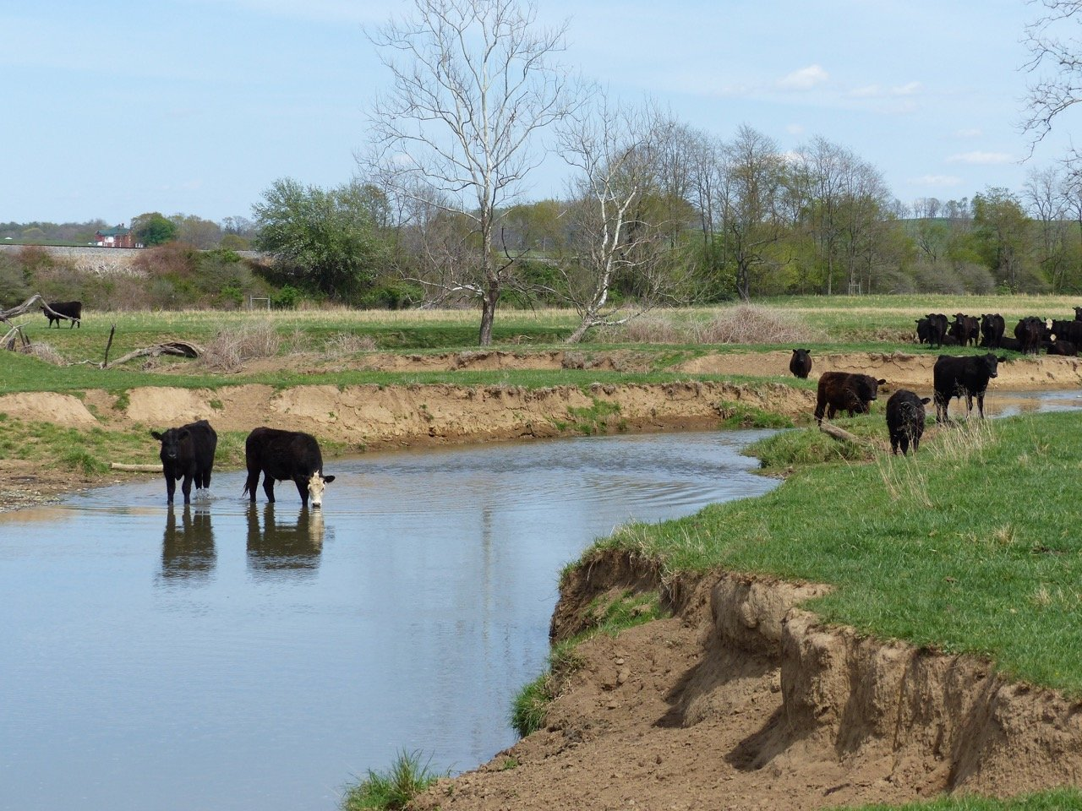
Microbial contamination of water can result from:
Cattle having access to a river or lake that supplies drinking water
Slurry washing in after heavy rain
Septic tanks located too near a stream, river or lake.
Most people in Ireland get their water from rivers or lakes or reservoirs that are fed by surface water, so it’s important to keep them free of contamination.
Groundwater is another important source of water and that can get contaminated also.

Slide 9
Groundwater and Wells
Groundwater originates as rainfall that percolates through the soil to the underlying subsoil and bedrock.
Water Table
In places (aquifers), the groundwater can be tapped by a well, for human use
Saturated zone
Groundwater ‘flows’ through subsoil and cracks in bedrock, but very slowly (<0.5m per day).

Slide 10
Pollution source:
Unsealed & illegal landfill
Faulty septic tank
Leaking slurry pit
Leaking fuel storage tank, etc.
Groundwater and Wells Can Be Contaminated
Contaminated well.
Almost ⅓ of private wells are contaminated with E. coli.
Water Table
Groundwater
Pollution plume carried by groundwater flow
can enter surface waterbodies, e.g. lakes and rivers.
Notes:
“About 720,000 or almost two out of every 10 people in Ireland get their water from a private supply. Many people assume that their private well water is safe to drink and don’t treat it or get it tested. This should not be assumed, as a recent study found that E. coli, which can cause serious illness, is present in almost a third (29%) of Irish private wells.
Have You Checked Your Well Water Supply? EPA. https://www.epa.ie/media/epa-2020/environment-amp-you/drinking-water/Private-wells-protection-leaflet.pdf

Slide 11
Parts of Ireland where the soil cover is thin, especially over limestone bedrock, are more at risk of well contamination.
EPA publish advice on how to avoid well contamination and reduce health risks: https://www.epa.ie/environment-and-you/drinking-water/household-wells/
Notes:
e.g. The Burren, Co. Clare.

Slide 12
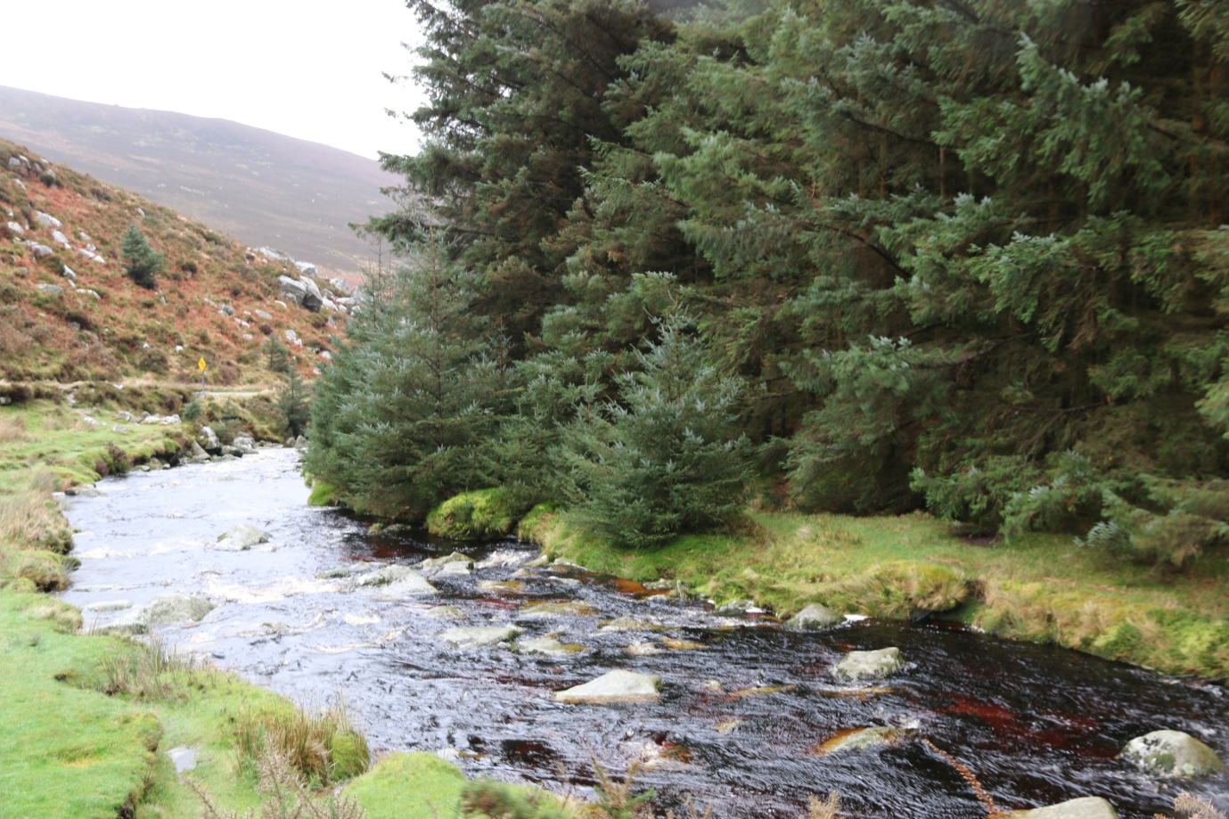
Acidification
An upland river in Co. Wicklow.
Its water is naturally acidic but is made more so by the conifer plantations that are planted right up to the water’s edge. It is too acid now for mayflies and young salmon to survive.
Buffer zones of natural vegetation, including native woodland, along river margins would help restore a better pH.
Notes:
Natural acidity is common in headwater lakes and streams, and the communities of animals and plants in these streams have become adapted to this over time. However, increases in acidity can cause physiological stress to many freshwater organisms and if prolonged, can lead to the elimination of more acid sensitive organisms. Mayflies and salmonids (particularly at the egg and fry stage) are particularly sensitive. Increases in acidity can also cause aluminium and other metals to be elevated to levels that are toxic to fish and invertebrates. What causes and increases in acidity? In upland rivers with little human activity the main source is organic acids derived from the surrounding peaty soils. Episodes of heavy rain can wash these into streams and dilute the buffering carbonate ions causing a spike in acidity. This is why measurements show that stream acidity in upland parts of the catchment is higher in winter and spring than in the summer, when flows are less. Heavy inputs of sea salt resulting from storms can also lead to temporary acidification. While these are natural processes, the intensity and duration of acid spikes can be exacerbated by deposition of airborne pollutants from human activities of or changes in land use such as afforestation.

Slide 13
Suspended Solids
Silt, sand and clay particles
A natural part of the river environment especially during floods
A flood is the river equivalent of a hurricane - it does a lot of damage. Particles clog fish gills and smother spawning beds
The impact is worse if the river banks have lost their natural vegetation and there are no plants or roots to strengthen the river bank - more suspended solids are eroded into the water.

Slide 14
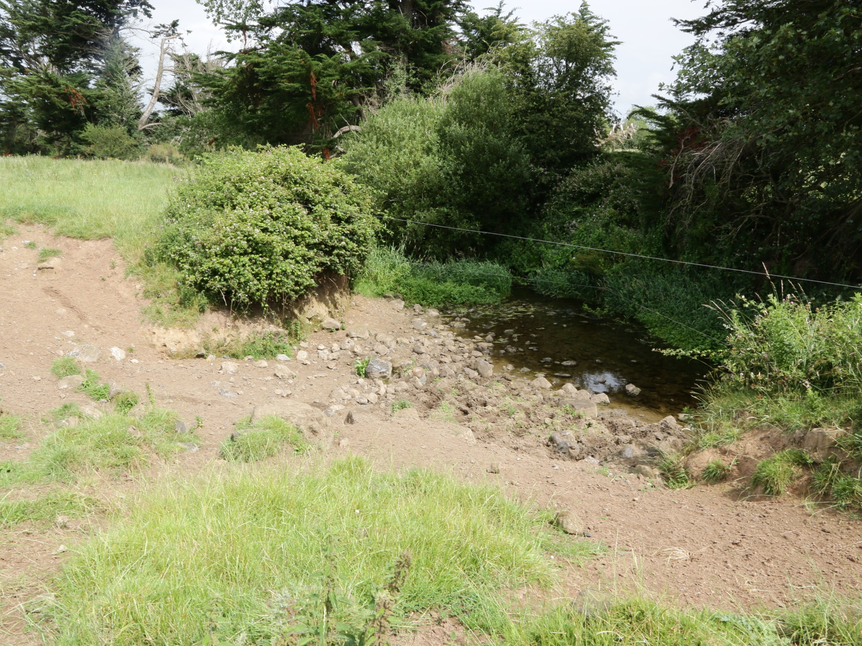
Suspended Solids
In heavy rain, a lot of sediment will be washed into the river from this cattle drinking spot

Slide 15
There are many sources of pressure on rivers and
lakes
Main pressures are agriculture (63%), hydromorphology, forestry and urban wastewater.
Urban wastewater is improving
Agriculture pressure is increasing
A river or lake can have multiple pressures
This image shows the pressures on our rivers and lakes (Source: EPA 2021).
This means that the aim of good ecological status for rivers and lakes by 2027 is very unlikely to be achieved!
Task 4.1
Notes:
Sources:
Water Quality in Ireland 2016 – 2021. EPA
https://www.epa.ie/publications/monitoring--assessment/freshwater--marine/water-quality-in-ireland-2016--2021-.php
A summary in Catchments.ie. https://www.catchments.ie/water-quality-in-ireland-2016-2021-the-quality-of-our-rivers-lakes-estuaries-and-coastal-areas-continues-to-decline

Slide 16
Agriculture and Water Quality
Pressure from agriculture is a difficult problem to solve because:
N and P fertilizers are used extensively to support crop production.
Pollution sources are diffuse and difficult to identify (there may be hundreds along a river).
Solutions being implemented:
Reducing nutrient application in sensitive catchments.
Better nutrient management on farms.
Intercepting nutrient run-off before it gets to rivers, lakes or groundwater (buffer strips).
Placing silt traps close to water bodies.
Calendars and technological fixes for slurry spreading.
More radical solutions are proposed by environmental groups but getting local buy-in is not guaranteed.
Notes:
Sources
Ireland’s Environment: An Integrated Assessment 2020.
Department of Housing, Local Government and Heritage. 2021. Draft River Basin Management Plan for Ireland 2022 - 2027

Slide 17
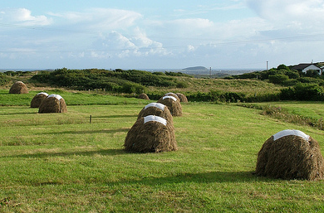
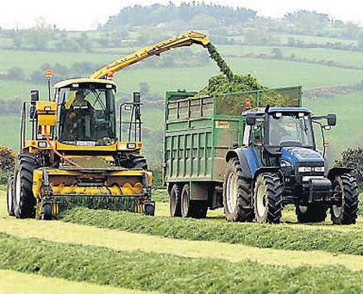
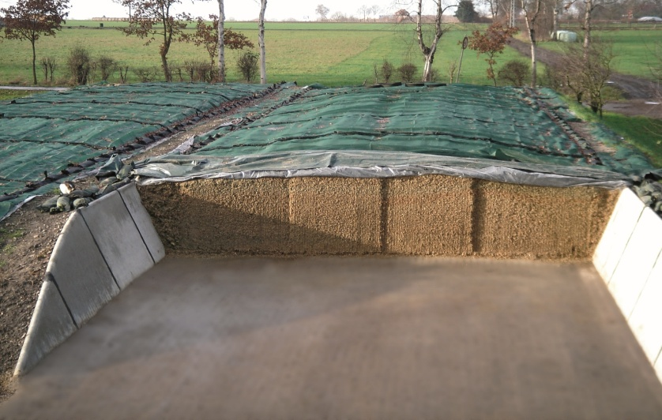
Technical Innovations and Changing Practices are Important
Switch from traditional hay to silage harvesting in early 1980s brought greater efficiency and productivity to agriculture

Slide 18
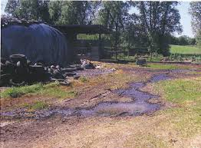
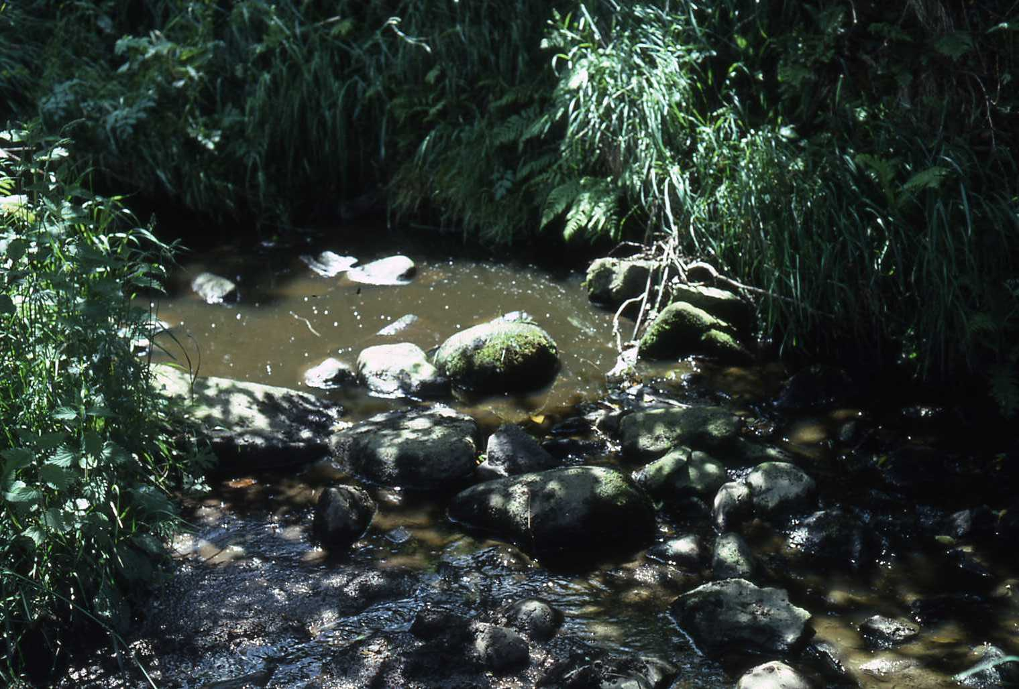
Effluent pollution
Silage effluent leaking from a pit
Pollution by silage effluent was a serious problem in the early days, but the introduction of bale- silage has now eliminated that.
This was a win-win for farming and the environment.

Slide 19
What we need to do to restore water quality and good ecological status in rivers lakes and estuaries? 5 ideas
1.
2.
3.
4.
5.
Task 4.2

Slide 20
Summary
Toxic Pollutants includes metals, pesticides, herbicides, chemicals and microbial pollutants.
Toxic pollutants damage or poison some vital system in the animal’s body; for example, cyanide, which prevents cell respiration resulting in paralysis and death. Impacts also impair nervous systems, immune systems, reproduction and can cause cancers.
Microbial Pollution is caused by bacteria, parasites and other micro-organisms that can contaminate aquatic ecosystems. Most of the harmful micro-organisms are found naturally in gut of domestic and wild animals, and humans. They get into water when it’s contaminated by faeces and urine.
Acidification when the pH level of water is increased owing to coniferous plantation along with waters edge, this has negative impacts on aquatic organisms.
Suspended solids silt, sand and suspended particles washed off the land can clog fish gills and destroy micro-habitats needed for macro-invertebrate life and fish reproduction.
Pollution challenges - how to produce food without negative environment impacts.

