Slide 1
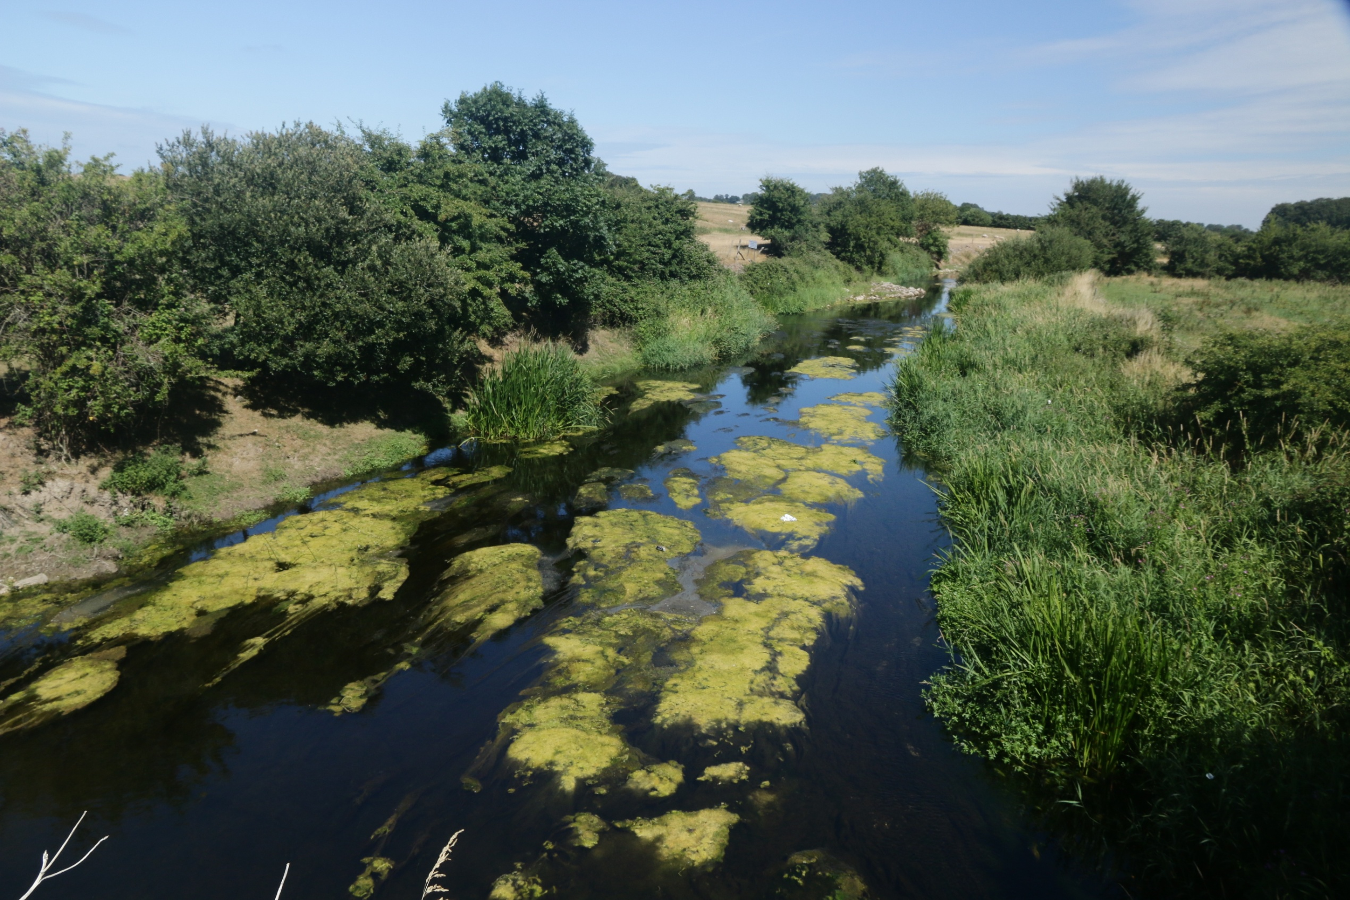
Water Quality and Pollution
Lesson 3. Nutrient pollution in rivers and lakes

Slide 2
Nutrient Pollution
This river is suffering from nutrient pollution.
Too much algae is growing on the river bed and forming floating mats.
Warm weather in summer, little shade (no trees) make the problem worse.
What’s the effect of this on river life? Again, O₂ is the key.

Slide 3
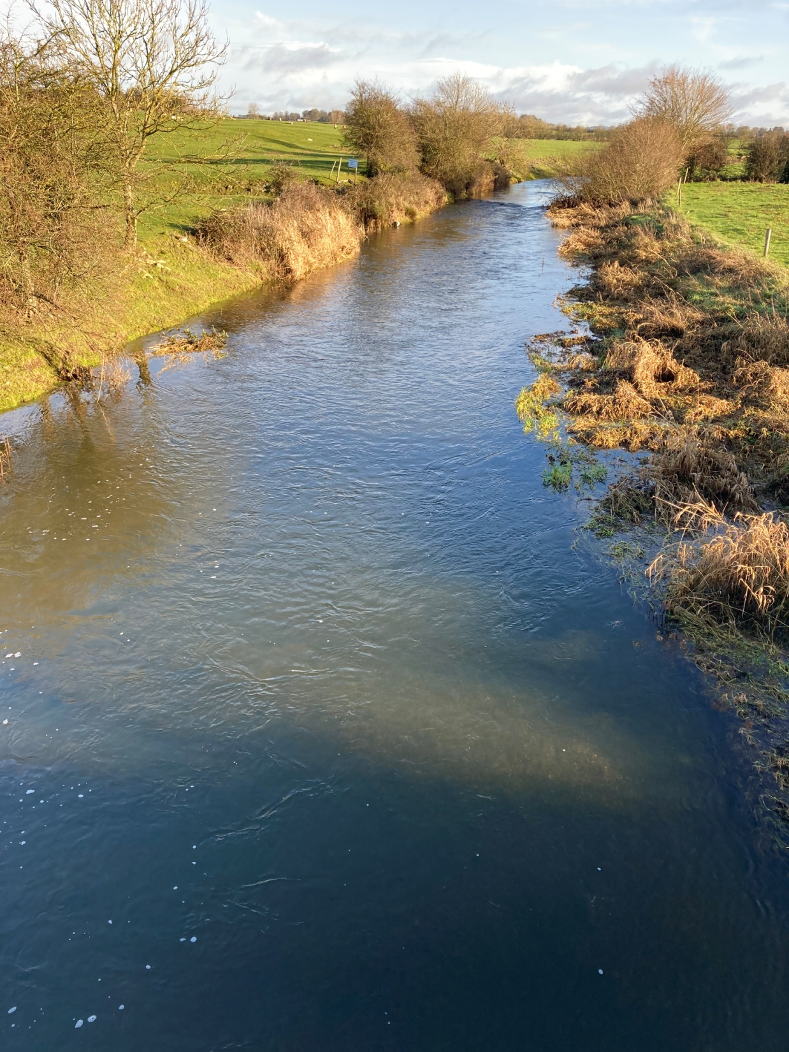
This is the same river
in winter

Slide 4
Nutrient Pollution
Nutrient pollution also causes deoxygenation.
Most widespread and serious form of pollution in Irish rivers and lakes. Is also known artificial eutrophication (enrichment).
Caused by phosphorus (P) on its own, or nitrogen (N) and phosphorus together.
In nature, N and P are the two main nutrients driving plant growth. In healthy rivers and lakes, N, and in particular P, are in short supply.
If excess nutrients get into a river or lake, they promote plant growth (mainly algae).
Disturbs the O₂ balance in the river or lake
Changes the whole ecology of the river or lake
Following slides show what happens
Notes:
Fertilizer sales in Ireland data from the Central Statistics Office (online) https://www.cso.ie/en/releasesandpublications/ep/p-fsa/fertilisersales2021/#:~:text=Key%20Findings,in%202020%20at%20399%2C164%20tonnes.

Slide 5
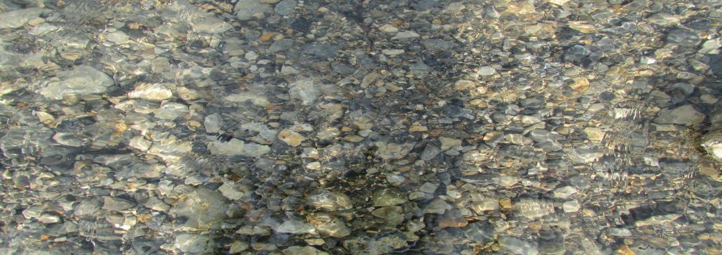
Bed of a river with very few nutrients. Very little obvious plant life
Small patches of algae attached to stones

Slide 6
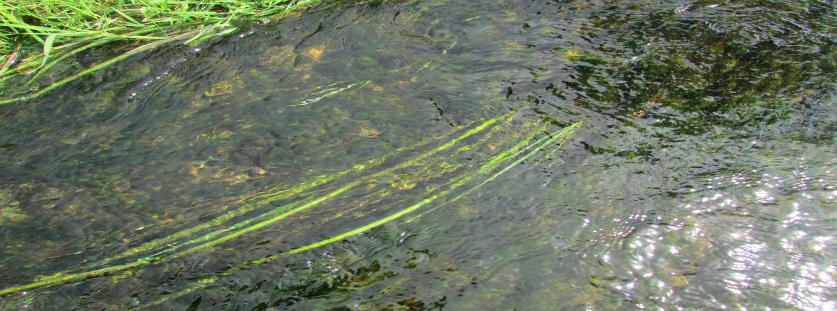
This river has high levels of nutrients. Too much algae on river bed.

Slide 7
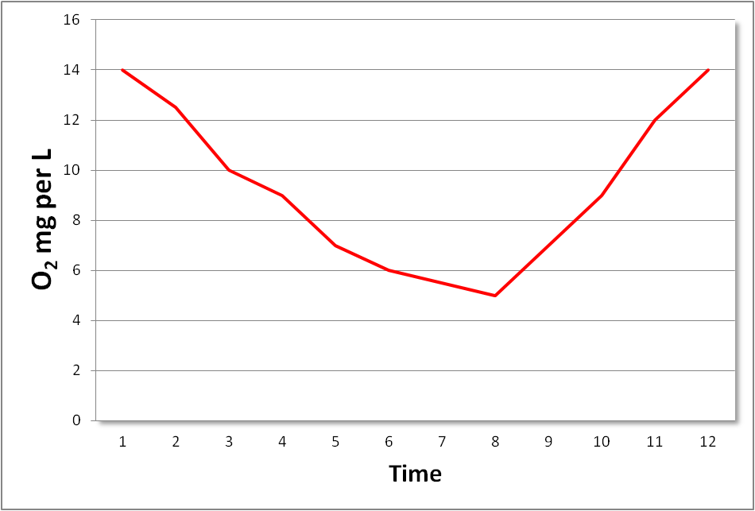
Come nightfall, all of this algae will begin to remove the O₂ in respiration.
Just before sunrise, O₂ levels will be very low. Fish kills often happen at this time.
4pm
4pm
O₂ 40% above saturation
6am
O₂ 50% below saturation
After a while the algae will begin to die off and decay, removing more O₂.

Slide 8
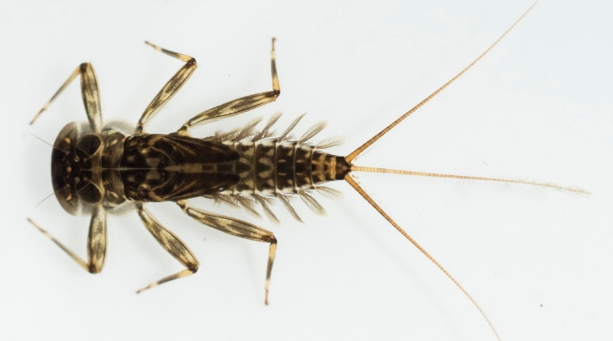
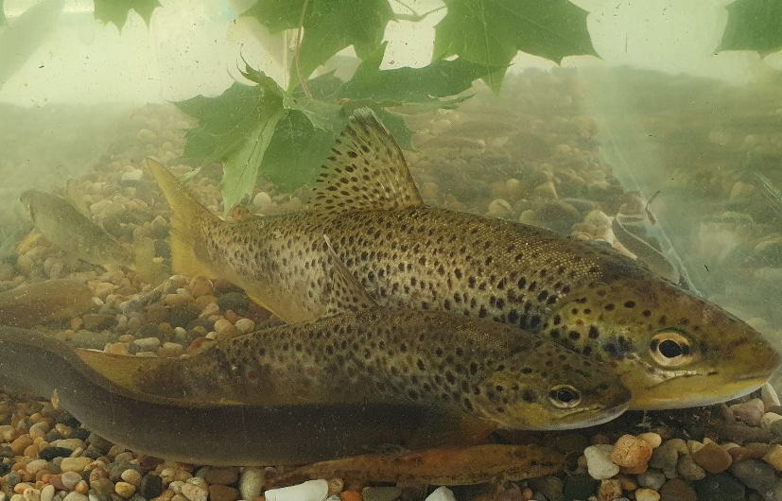
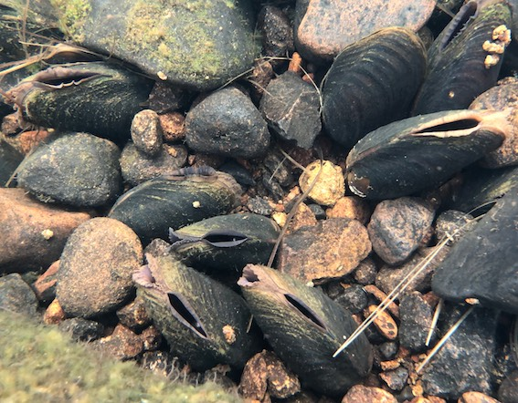
Nutrient pollution gradually kills animals that need good levels of O₂
Trout and Eel
Mayfly
Salmon
FW Pearl Mussel
When salmon and freshwater pearl mussel are gone they may never return to the river.

Slide 9
Nutrient pollution is the biggest problem in Ireland’s rivers.
All ecosystems need N and P, but how much is too much?
?%
?%
?%
Average N concentration (as nitrate, NO₃) in river water of >11.5 mg/L is too high.
Average P concentration (as phosphate, PO₄) in river water >0.035 mg/L is too high.
?%
Nitrate in Rivers
?%
?%
?%
?%
Task 3.1
Find the % of rivers that have too much N and P.
Where are the problem areas for N and P pollution of rivers in Ireland?
Are things improving or deteriorating since 2016?
You will find this information in the EPA website. Details are in your Workbook.
?%
?%
?%
?%
Phosphate in Rivers
?%
?%
Notes:
31% of rivers sites have to much N (>11.5 mg/l).
32% have too much P (>0.035 m/l)
Most of the rivers with excess N are in the East and South-East because of free-draining soils
Most of the rivers with excess P are in the Midwest and Midlands because of heavier soils.

Slide 10
Lakes
- Nutrient pollution affects them differently

Slide 11
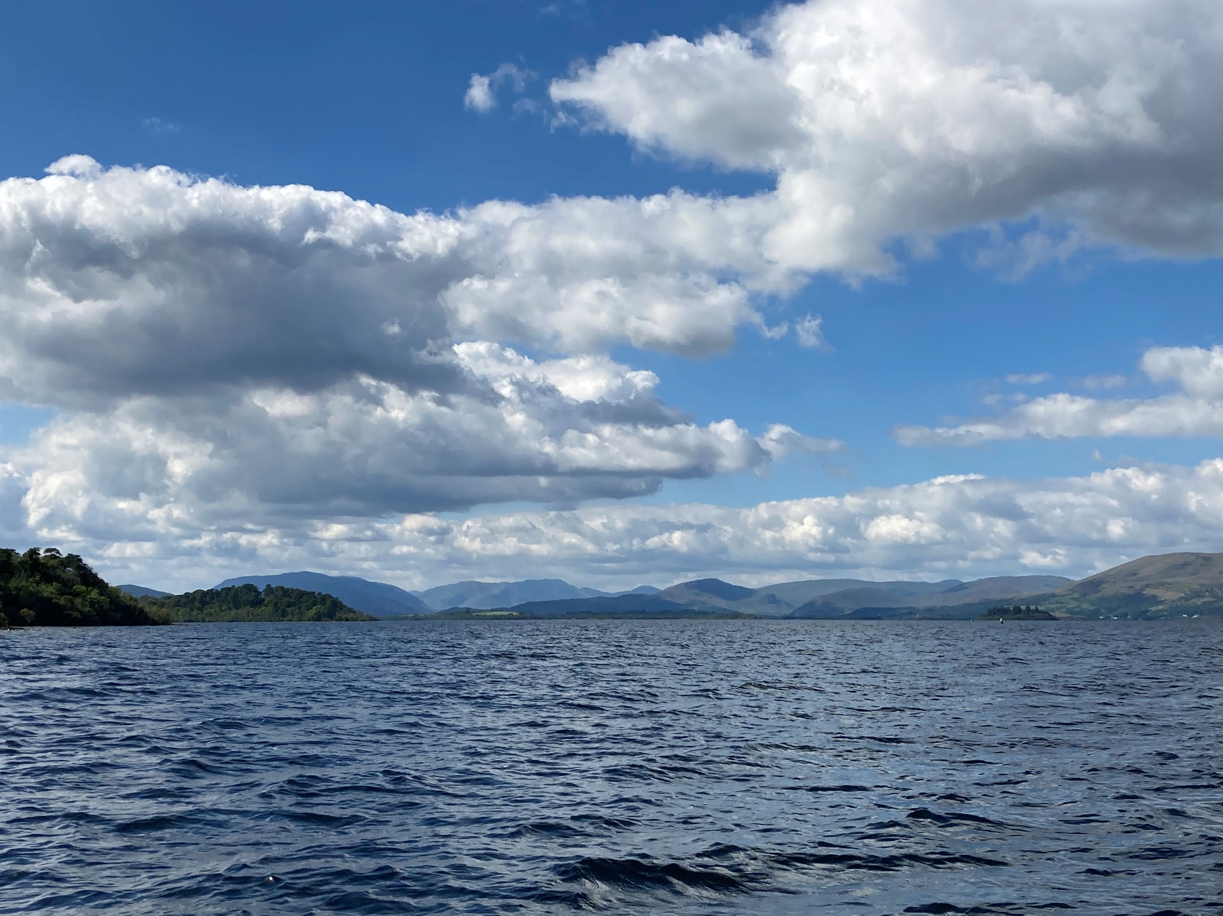
Most still have good ecological status.
However, about 30% are suffering from nutrient pollution.

Slide 12
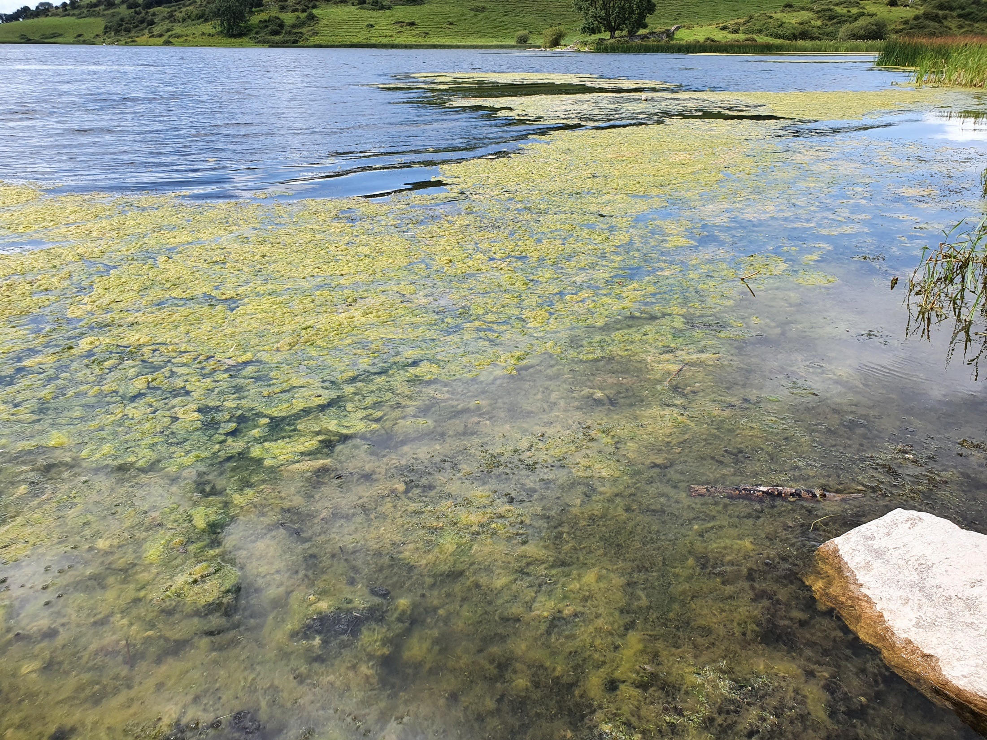
Nutrient pollution causes lake enrichment
or artificial eutrophication.
A bad algal bloom caused by excess nutrients in a lake
Notes:
Nutrient pollution by nitrogen and phosphorus is the single biggest cause of water pollution in rivers and lakes in Ireland. Excess nutrients promote excessive plant and algal growth, which reduces oxygen levels through respiration and decay of the plant biomass. Students will have learned from the previous lesson about the impact of deoxygenation on animal life in rivers. The impact on lakes, manifested as algal blooms, is more profound, because blooms eliminate oxygen in the deeper parts of the lake in summer and restrict the light available to plants in the lake shallows. These (also known as the littoral zone) are where most of the invertebrate life is found. Elimination of the submerged marginal plant life reduce biodiversity and disrupts and simplifies food webs in the lake. Declines in the populations of brown trout and mayflies are early warning signs of the onset of nutrient pollution in lakes (also known as artificial eutrophication). Blooms consist mainly of algae (blue-green algae or cyanobacteria) that can take advantage of the excess nutrients at the expense of diatoms, the dominant phytoplankton types in unpolluted lakes. Nutrient enrichment in many lakes can be difficult to reverse, even when the source of excess nutrients is removed. Phosphorus can remain in lake sediments and be remobilized to promote algal blooms year after year. This is more likely to happen in smaller lakes with no or limited outflow where there is very little flushing out.
Nutrient pollution of rivers and particularly lakes means that the ecosystem services offered by the are greatly impaired. Loss of biodiversity, especially of endangered species such as salmon, pearl mussel, is an obvious impact. If these, arctic char and endemic fish species are eliminated from a river or lake they are very unlikely to recolonize.
Loss of the beneficial uses of rivers and lakes to humans is another impact. As well as changing the ecology of the lake nutrient pollution can make the lake unusable for drinking water. Algal blooms can :
Clog filters and make it difficult to abstract water .
Some contain toxins that can make the water unusable and can poison livestock and other animals.
Destroy trout fisheries with impacts on local incomes fro tourist angling.
Reduce recreational value of lakes for swimming and boating.
Sources of excess nutrient with the potential to cause nutrient pollution are urban wastewater, agriculture, forestry and private waste water treatment (septic tanks). Agriculture is largest contributor; loss of nutrients from agriculture have increased in recent years as a result of the ongoing expansion and intensification of agriculture. In areas with freely draining soil, nitrate losses are closely correlated with application of nitrogen, the higher the nitrate concentrations in waters. Since 2013, nitrogen emissions have increased as both cattle numbers and fertilizer use have increased. Losses of phosphorus have also increased particularly from poorly draining soils. Diffuse nutrient losses from agriculture are difficult to tackle as the sources do not occur uniformly in the landscape, but from ‘hot spots’ or critical source areas.
Photo credit: Maigue Rivers Trust.

Slide 14
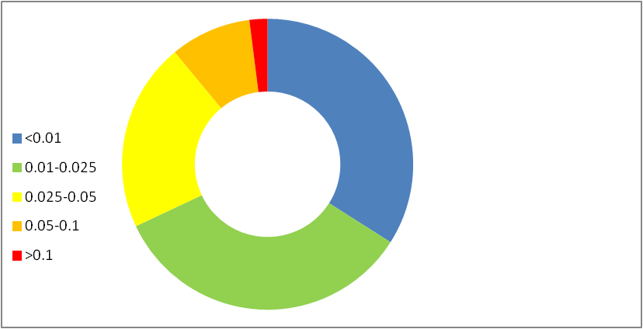
Phosphorus is the main cause of nutrient pollution
in Irish lakes
2%
9%
One-third of the 222 lakes monitored in Ireland have too much P and show the signs of artificial enrichment.
34%
21%
Phosphorus
in Lakes
34%
As well as changing the ecology of the lake nutrient pollution can make the lake unusable for drinking water. Algal blooms can :
Clog filters and make it difficult to abstract water .
Some contain toxins that can make the water unusable and can poison livestock and other animals.
Destroy trout fisheries.
Reduce recreational value of lakes.

Slide 15
Where do the excess nutrients come from?

Slide 16
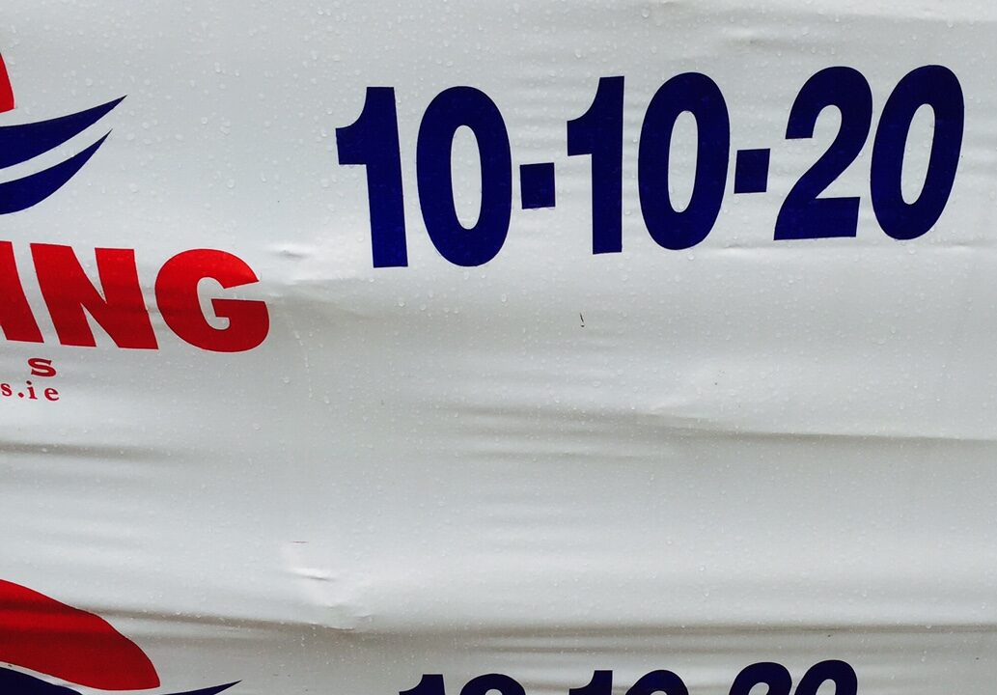
Where do the excess nutrients come from?... continued
Intensive agriculture is the main source of nutrient pollution in Ireland.
N and P fertilizers are needed to support production of grass and crops.
Artificial fertilizer and animal manure (slurries) are the sources of N and P.
Cattle and pigs that are housed produce a lot of waste or slurry that must be stored in tanks.
Slurries contain N and P and are spread as fertilizer on grass pastures.
Care has to be taken in the use of fertilizers, otherwise nutrients will end up in rivers and lakes rather than in the crop.
e.g. If the land is too wet, nutrients in the slurry may run-off into drains and streams.
Artificial fertiliser
Manure / slurry spreading
Notes:
Sources
Ireland’s Environment: An Integrated Assessment 2020.
Department of Housing, Local Government and Heritage. 2021. Draft River Basin Management Plan for Ireland 2022 - 2027

Slide 17
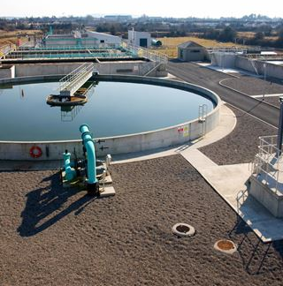
Where do the excess nutrients come from?
A number of possible sources:
Urban wastewater (Raw sewage)
Wastewater Treatment Plant
In villages, towns and cities sewage should go to.....
Breaks down the organic material in the waste and removes the N and P contained in the waste.
Treated wastewater
Is released to rivers and lakes
This should not contain any organic matter or nutrients IF the plant is modern, not overloaded and operating properly. This may not always be the case.....

Slide 18
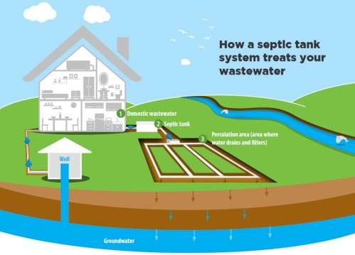
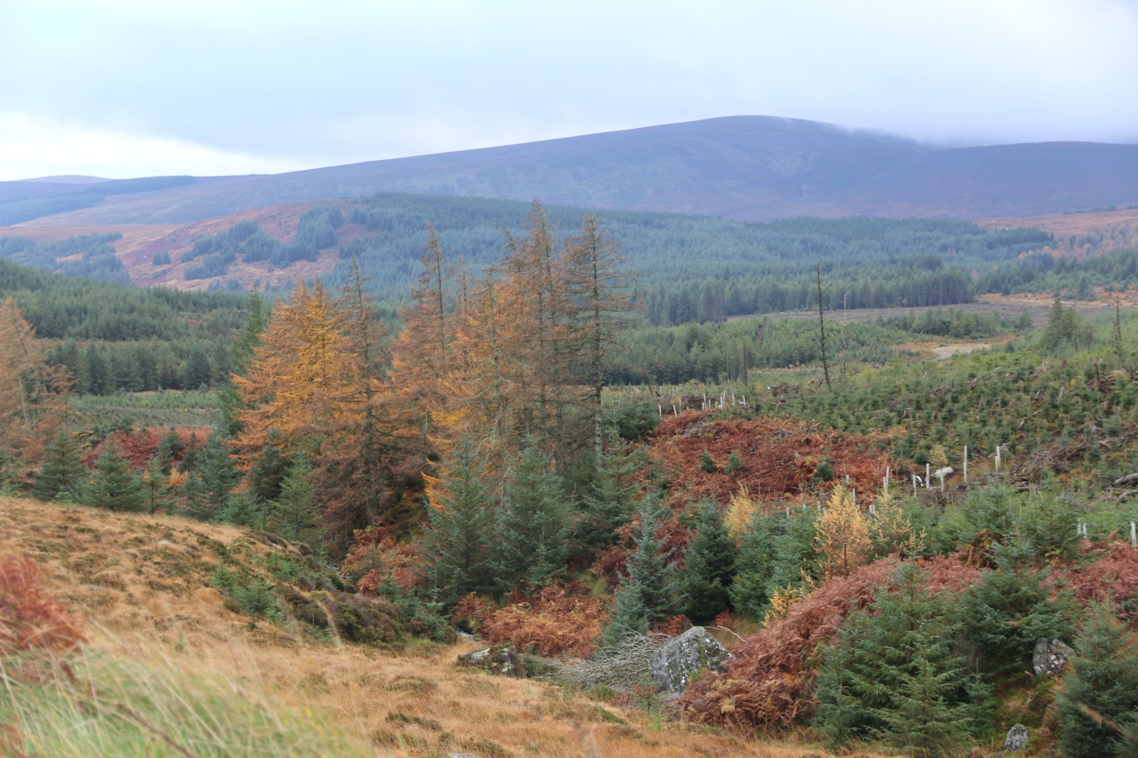
Where do the excess nutrients come from?... continued
Septic tanks
In rural areas waste from houses are treated in domestic septic tanks.
Septic tanks need to properly located constructed and maintained otherwise they can be a source of pollution.
Forestry
Conifer plantations can acidify streams but also release nutrients and sediment when clear-felled

Slide 19
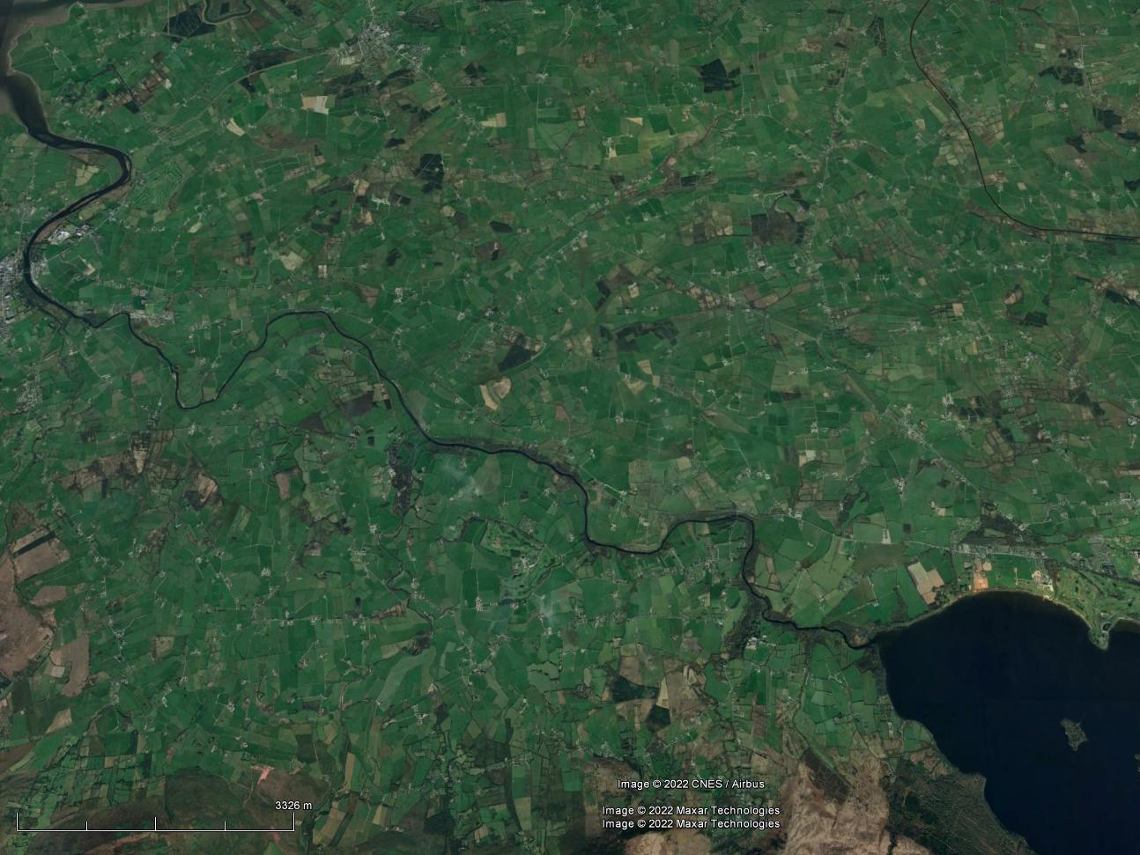
Point sources of nutrients such as wastewater plants are usually easily identified, but agricultural sources are diffuse and difficult to identify.
There may be hundreds of pollution sources over the course of a river or around a lake
Moreover, the sources do not occur uniformly in the landscape, but from ‘hot spots’ or critical source areas.
TASK 3: Answer questions in Student Workbook based on information in EPA reports
TASK 3.2: Answer questions in Student Workbook based on information in EPA reports
Notes:
What are Critical Source Areas?
Critical sources areas are areas that deliver a disproportionally high amount of pollutants compared to other areas of a water body or subcatchment, and represent the areas with the highest risk of impacting a water body. In order to determine where critical source areas are located, we need to determine the hydro(geo) logical susceptibility of the water body and also the nutrient loadings applied to that water body.
Ref. https://www.catchments.ie/water-quality-agriculture-pollution-impact-potential-maps-tool-guide-resources-areas-investigation/

Slide 20
Summary
Excessive Nutrients such as Phosphorous and Nitrogen in waters is the biggest cause of pollution in rivers and lakes.
While some nutrients are necessary too much causes excessive plant and algal growth that results in deoxygenation of waters that harms ecosystems and can kill fish.
Intensive agriculture is the main source of nutrient pollution (artificial fertilizer and animal manure)
Wastewater treatment, septic tanks and forestry activities are also sources.
Pollution can have point sources (wastewater treatment plant) of diffuse sources (many farm buildings/slurry applications).

