Slide 1
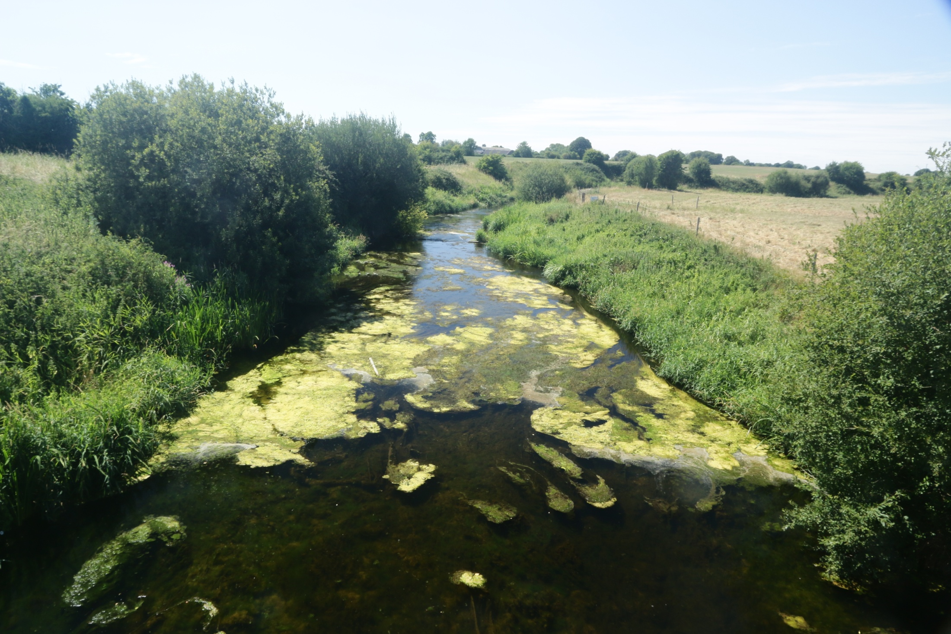
Water Quality and Pollution
Lesson 2. Organic pollution in rivers and lakes

Slide 2
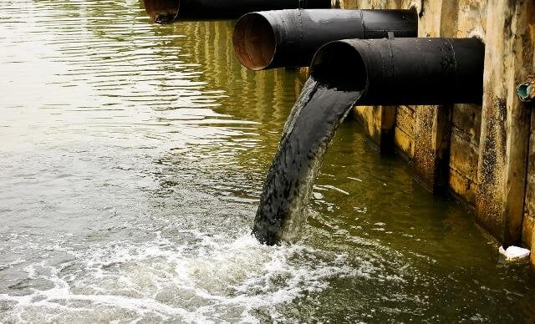
What is Water Pollution?
Several definitions, but all involve:
Contaminants released by human activity
Reduction in water quality and ecological status
Damages the ecosystem services offered by rivers, lakes and groundwater
This example is easy to identify – it is a very obvious Point source.
Other types of pollution are not so easy to detect - they have diffuse sources.
Notes:
Diffuse Pollution Definition
Is the release of potential pollutants from a range of activities that, individually, may have no effect on the water environment, but, at the scale of a catchment, can have a significant effect. Problems occur in both rural and urban environments.

Slide 3
Pollution incidents occur as:
Point source
Is a single identifiable source of pollution such as a discharge pipe
Diffuse Pollution
Is the release of potential pollutants from a range of activities that, individually, may have little effect on the water environment, but, at the scale of a whole river catchment, can have a significant effect.
Diffuse pollution problems occur in both rural and urban environments.
Can you think of any examples?

Slide 4
Types of Pollution
Both reduce O₂ in river and lakes. They are also known as Deoxygenating Pollution.
Nutrient pollution is the most widespread form of pollution in Irish surface waters.
Organic Pollution
Nutrient Pollution
There are three other less common types of pollution that work differently:
Toxic Pollution
Acidification
Suspended Solids

Slide 5
Oxygen is key to the health of rivers and lakes
Atmosphere has 21% O₂. BUT there is only 1% dissolved O₂ in water!
Oxygen gets into (dissolves in) water in two ways:
1. Diffusion from atmosphere
O₂
2. Photosynthesis by aquatic plants and algae.....but at night plants will remove O₂ in respiration
O₂ is being constantly used up in respiration by animals, plants and especially micro-organisms that break down organic matter.

Slide 6
Oxygen is key!
The amount of O₂ dissolved in water (the O₂ solubility) depends on water temperature.
Warmer water holds less O₂ than cold water. At 16˚C, there is roughly 10 mg of O₂ in every litre of water. At 30˚C this is reduced by ¼.
Warm summers can be tough for animals that need high levels of O₂!
Notes:
The graph above is crucial to understanding why organic and nutrient pollution has such an impact on rivers and lakes.
Students will be familiar with the idea of solubility and solids dissolving in water, but perhaps not with solubility of gases in water.
The line shows the concentration of O₂ expected in still, pure water (nothing using or producing oxygen in the water), exposed to the atmosphere at different temperatures. This is an equilibrium line: O₂ is being lost to the atmosphere by outward diffusion but is also gaining O₂ at the same time by inward diffusion from the atmosphere. It shows water saturated with O₂.
Cold-blooded animals need much more O₂ at higher temperatures because temperature raises metabolic rate. For example, at 5 ºC trout use about 50-60 milligrams (mg) of oxygen per hour; at 25 ºC they may need five or six times that amount.
In rivers and lakes, dissolved O₂ levels can deviate greatly from this equilibrium from place to place and over the course of the day (in summer):
Plant life (photosynthesising organisms) release O₂ during the day so the water becomes super-saturated with O₂. This excess O₂ diffuses outwards to the atmosphere but the rate of diffusion is slow (10,000 times less than in air) , so the levels in water are temporarily elevated.
Conversely, at night, plant biomass respires and removes O₂ from water faster than it can diffuse inwards, so O₂ levels are depressed. or unsaturated.
Turbulence-waterfalls, rapids, wind-generated waves increases the amount of O₂ in water above the expected –. This happens because the surface area of the water increases with turbulence , so the ‘space’ for diffusion increases.

Slide 7
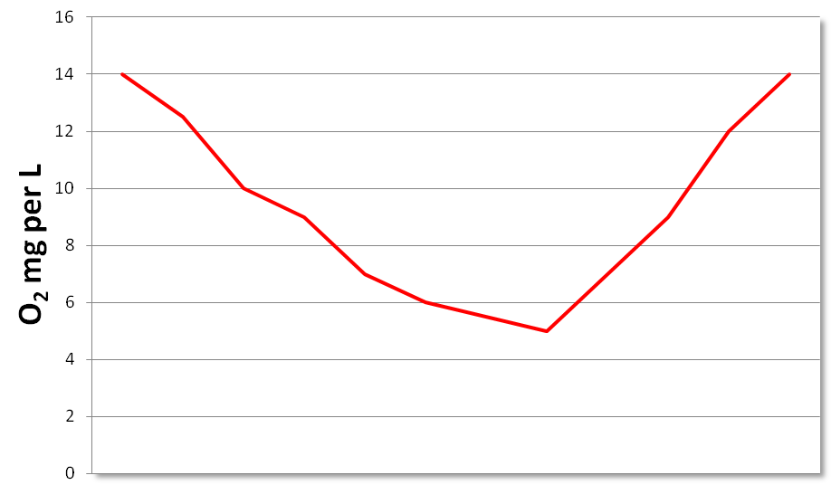
In summer, O₂ levels vary over 24 hours
O₂ 40% above saturation (super-saturated) produced by plant life in river during day
O₂ is consumed at night in respiration and decomposition.
By sunrise it can be low.
4pm
4pm
O₂
O₂
O₂ 50% below saturation
6am
O₂
x

Slide 8
Task 2.1
Deoxygenating Pollution
Deoxygenating means that dissolved O₂ in water is removed as a result of pollution.
All animals need O₂ for respiration. As O₂ level drop, they become stressed, and when O₂ disappears, they die.
Some freshwater animals such as and and require lots of O₂, while others, such as and require much less.
Freshwater plants also need O₂. They can produce it themselves during the day by photosynthesis but they need O₂ at night for . However, unlike animals, plants can withstand long periods of low O₂ .
Micro-organisms that carry out decomposition such as many bacteria and fungi also need O₂. These are aerobic while others are anaerobic and can function without O₂ .

Slide 9
Organic Pollution

Slide 10
Organic Pollution
Organic pollutants are also known as ‘deoxygenating pollutants’
Organic pollution is caused by biodegradable organic matter entering a river or lake.
Organic means composed of the elements that make up living things; carbon, hydrogen, nitrogen, phosphorus. It is the residue of living things or life processes.
Biodegradable means that micro-organisms can use it as a source of energy and break it down (decompose) it in the process.
When a large volume of biodegradable organic matter enters a river, micro-organisms begin to decompose the matter, multiply, and use up the O₂. (High Biological/Biochemical Oxygen Demand BOD)
Organic pollutants come in many forms:
Sewage effluent Animal slurry
Food processing effluent Silage effluent

Slide 11
A sewage effluent discharge or outfall

Slide 12
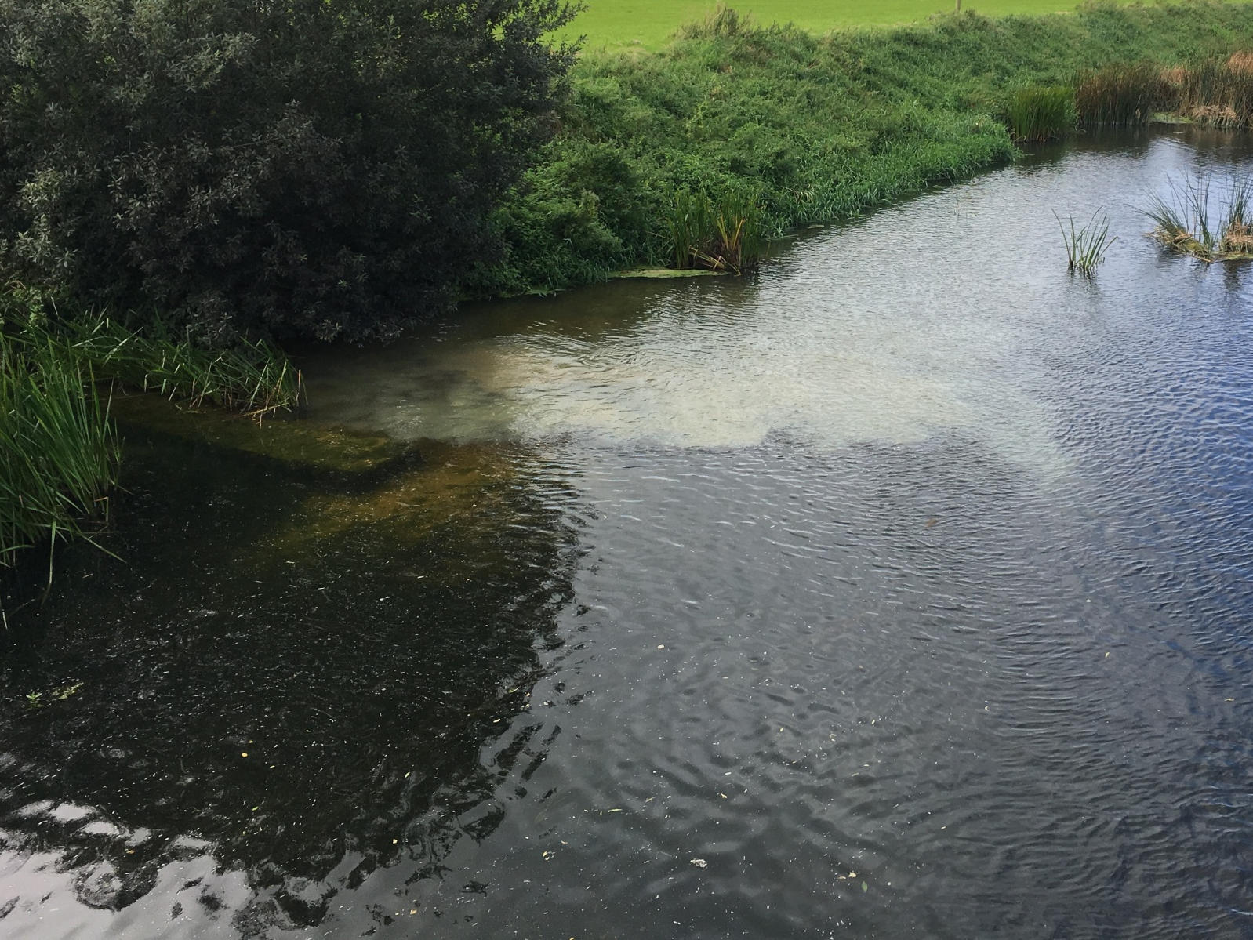
Spillage from a wastewater treatment plant

Slide 13
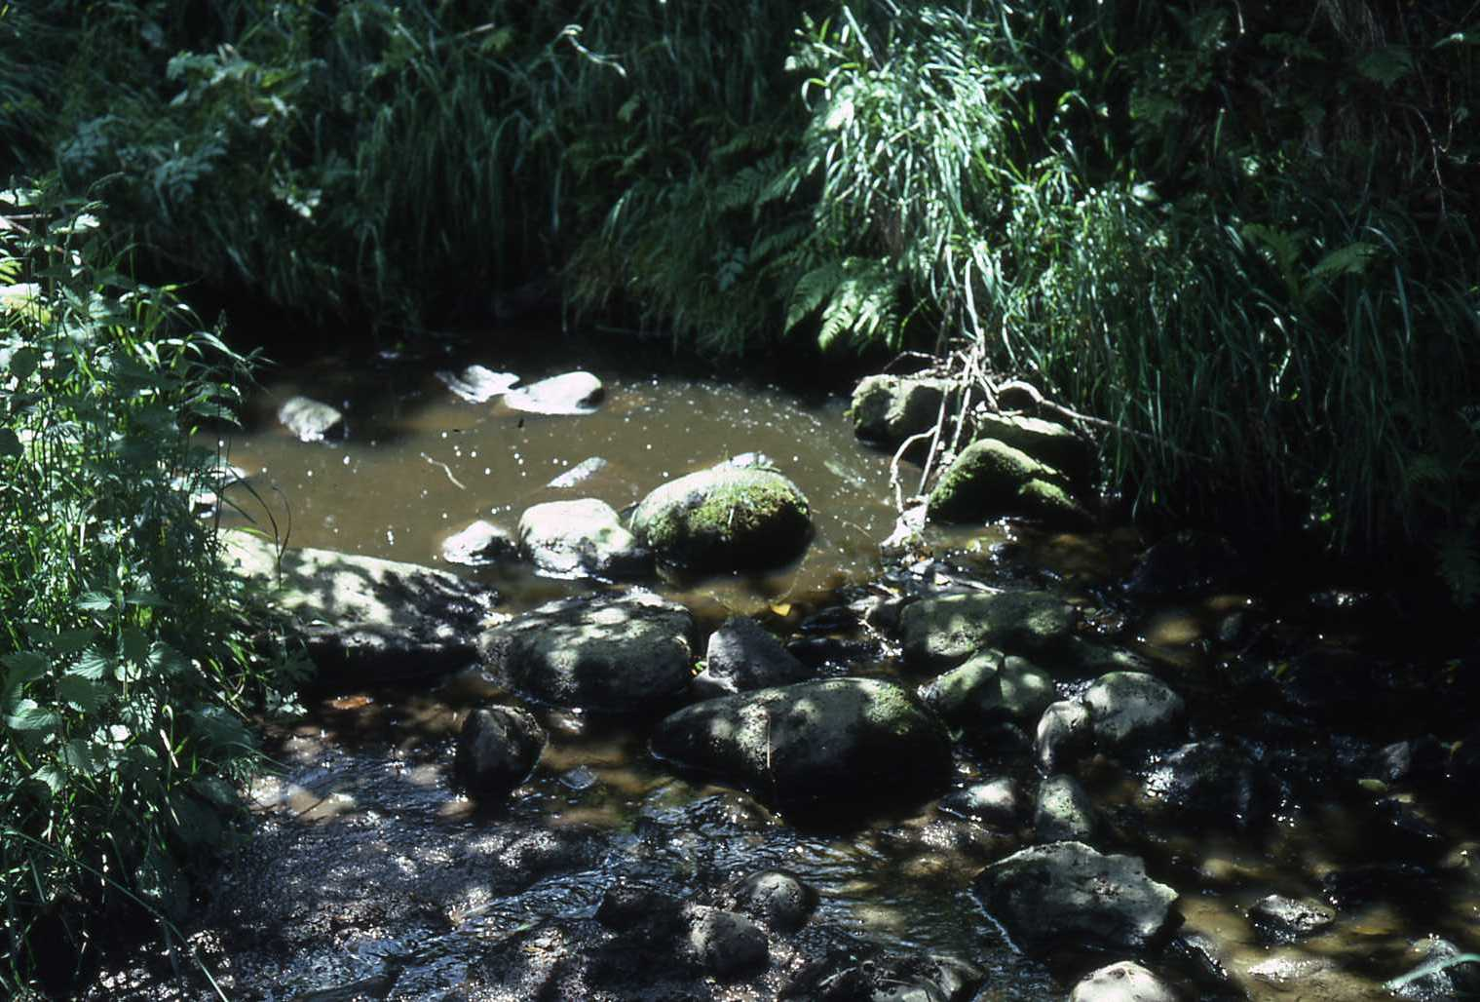
Creamery effluent
entering a river
A small feeder stream polluted by silage effluent

Slide 14
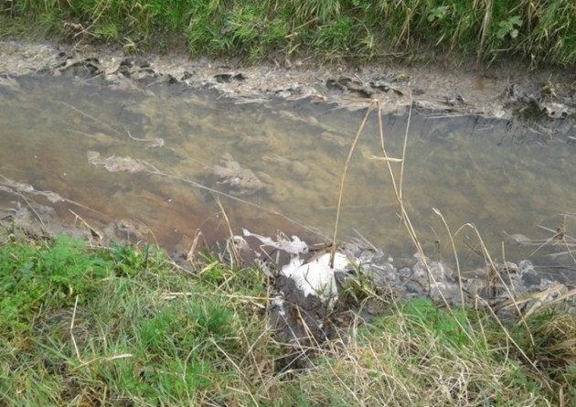
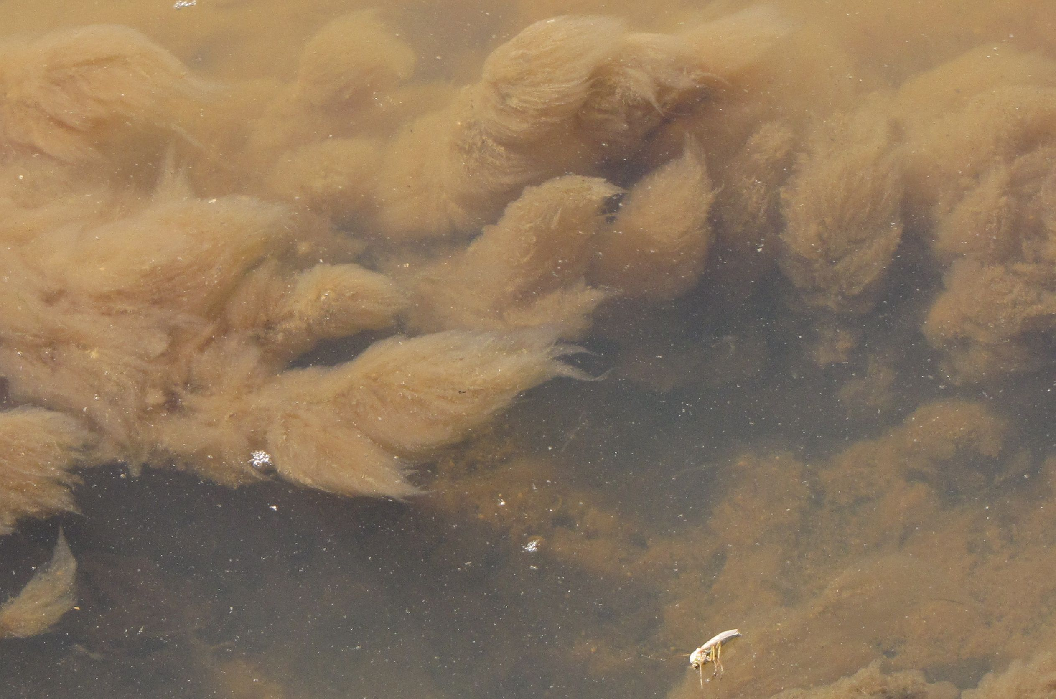
Small stream heavily polluted by an organic effluent - farmyard runoff. Dead apart from bacteria and ‘sewage fungus’ that are breaking down the effluent

Slide 15
Slurry from a ruptured storage tank entering a river (note foaming)
Sources of organic pollution are often single or ‘point’ sources

Slide 16
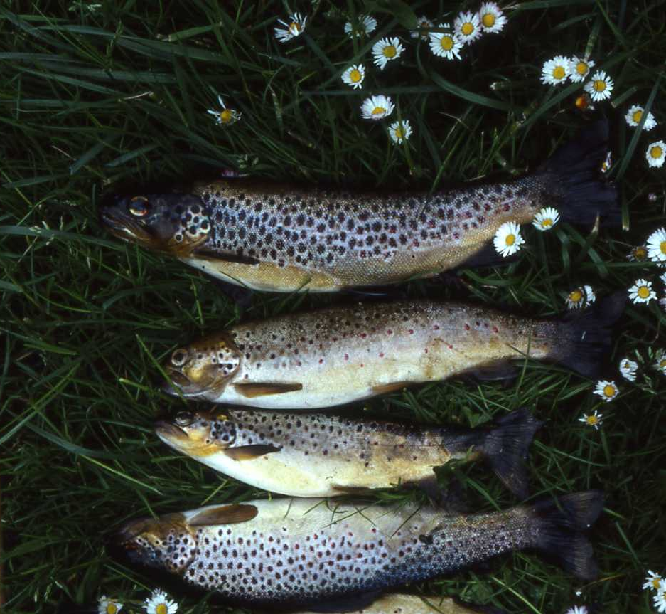
Fish Kills
Severe organic pollution will strip most of the O₂ out of the water, resulting in the sudden death of fish and invertebrate life.
– Fish Kills
Less severe organic pollution can have the same effect but over a longer time span.
If O₂ concentrations drop below 70% saturation by day or night over an extended period of a few weeks in summer, young salmon, trout, stoneflies and mayflies will begin to die off because of Oxygen starvation
Aftermath of a fish kill caused by organic pollution. Trout and salmon need a lot of O₂ in the water. These trout have suffocated from lack of O₂.
Notes:
“Natural’ Fish Kills – the dissolved oxygen challenge
A common cause of fish kills, particularly in summer is the level of dissolved oxygen in water. Warm water holds less dissolved oxygen than cold water, so summer is the time when fish can have a hard time getting enough oxygen. Other organisms use oxygen too including the algae that grow in the summer and bacteria that degrade organic matter. During the day, the algae produce oxygen through photosynthesis, but at night, when photosynthesis stops, they and other organisms keep respiring, using up oxygen. So, on warm summer nights the dissolved-oxygen concentration sometimes drops too low for the fish, and a fish kill can occur. This can happen as a result of natural conditions but more often happens because of the addition by humans (inadventently or otherwise) of nutrients such as nitrogen and phosphorus to water systems. These nutrients ‘enrich’ our surface waters, supporting vigorous and excessive growth of vegetation, algae and microorganisms. With all this additional growth and respiration, there is much more competition for oxygen (which means less oxygen for fish). Times of higher water temperatures generally mean more challenging and difficult conditions for our fish populations in Ireland.”
Source: Inland Fisheries Ireland. https://www.fisheriesireland.ie/what-we-do/protection/environmental-protection/fish-kills

Slide 17
Summary
Water Pollution is caused by contaminants released into the water by human activity.
Water Pollution reduces water quality and damages the waterbodies ecosystem.
Water Pollution locations are defined by their entry point:
1. Point source pollution or 2. Diffuse pollution
There are 5 types of pollution:
1. Organic 2. Nutrient 3. Toxic 4. Acidification 5. Suspended solids
Organic and Nutrient Pollution reduce the O₂ levels in water bodies
O₂ is key to the health of all waterbodies
Organic pollutants are known as deoxygenating pollutants
Organic pollutants come from:
1. Sewage effluent 2. Animal slurry 3. Food processing 4. Effluent 5. Silage effluent
Severe and long-term organic pollution causes fish kills.

