Slide 1
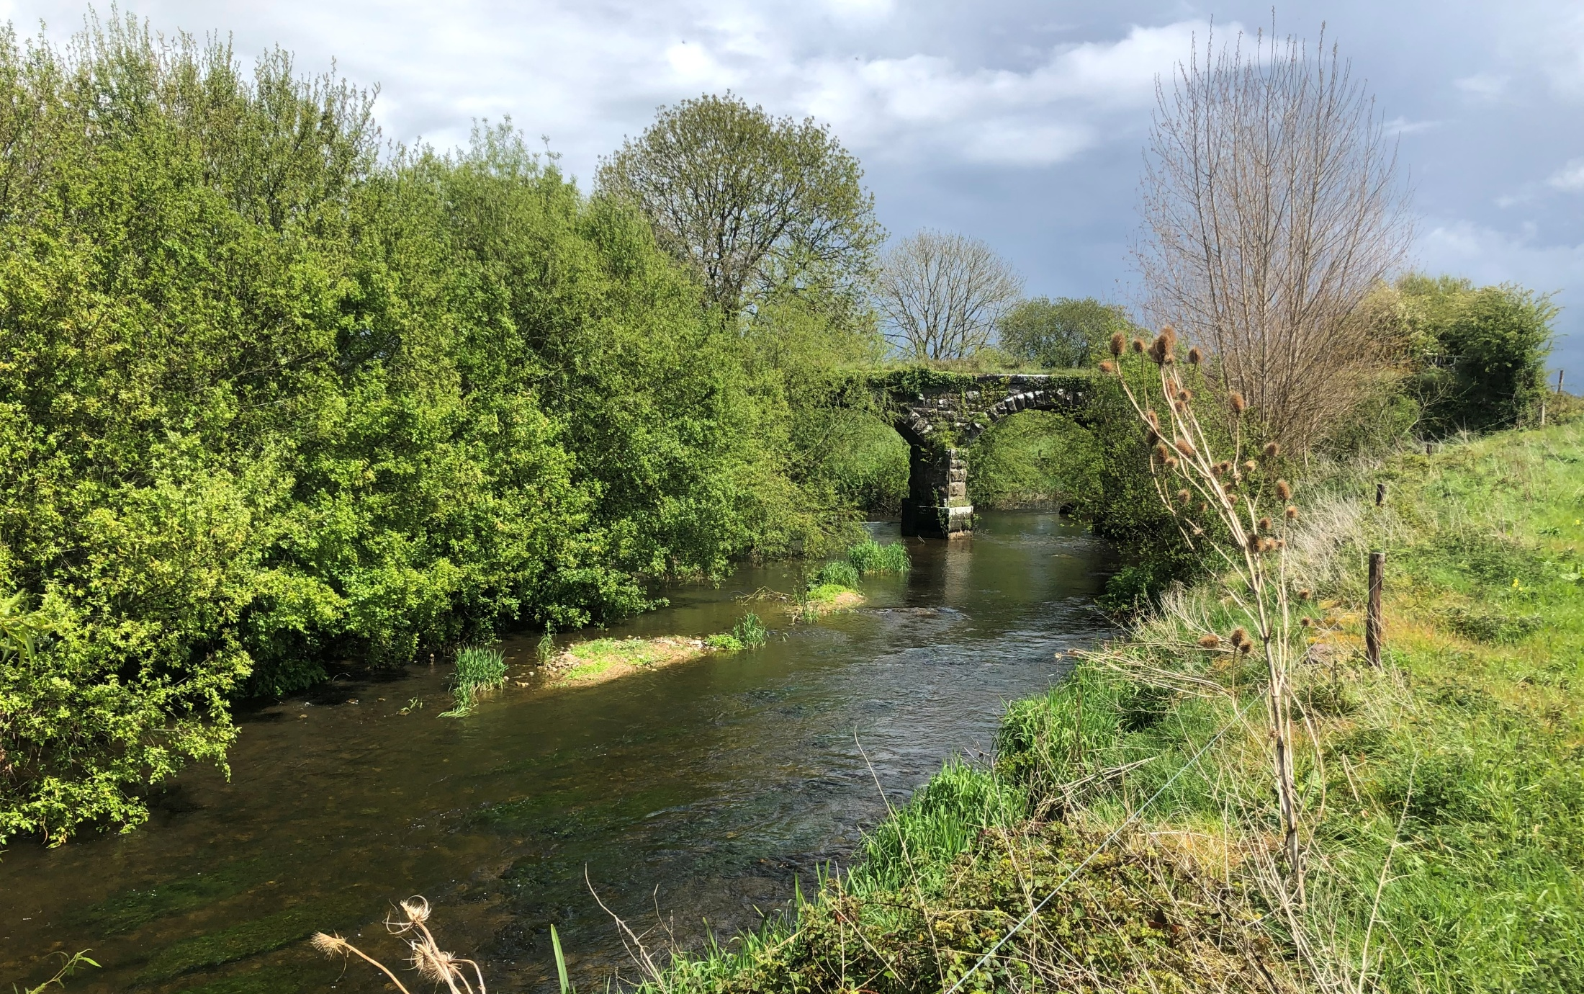
Water Quality and Pollution
Lesson 1. How water quality is assessed
Looks like a nice clean river, but too often, this happens......

Slide 2
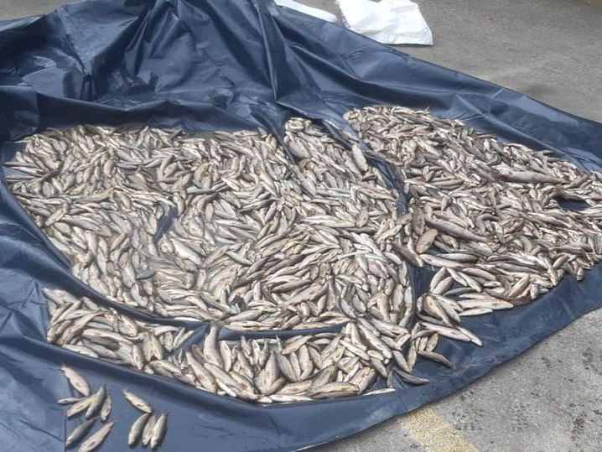
Thousands of fish found dead in Donegal river after member of public phones hotline.
“Inland Fisheries Ireland said it is following a 'definite line of inquiry' to determine the cause”
Irish Mirror 29/08/2022

Slide 3
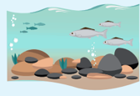
What is ‘Water Quality’?
Is a measure of how clean the water is, and whether it is suitable for drinking, a healthy living environment for fish and river life, farming, swimming, etc.
Water Quality is in the news a lot because it is declining.
“Water quality of our rivers, lakes, estuaries and coastal areas continues to decline, says EPA” - October 13, 2022
Declining water quality - means that the quality of the water that is needed to sustain the diversity of life in our rivers, lakes and estuaries is not as good as it should be and is getting worse.
*EPA =Environmental Protection Agency

Slide 4
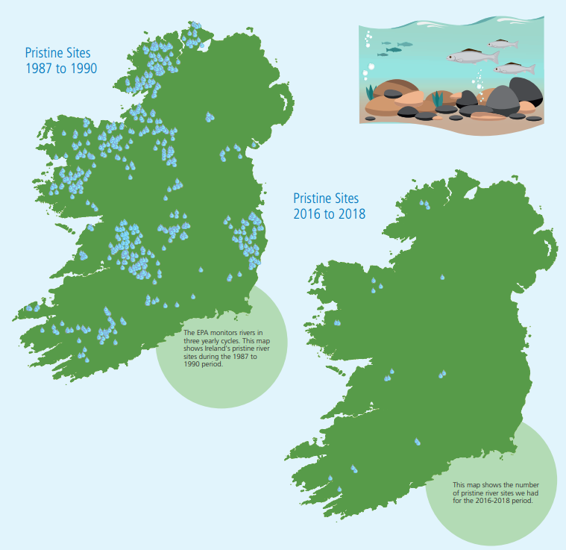
Irish Pristine River Sites
Each blue dot (500) is a pristine river site in 1990.
Pristine means in its original condition and unspoilt.
Now, there are only 35
There are ~2420 rivers and streams in Ireland
Source EPA: Ireland’s Environment: An Integrated Assessment 2020 & Water Quality in 2022 An Indicators Report
Notes:
https://www.epa.ie/publications/monitoring--assessment/freshwater--marine/water-quality-in-2022-indicator-report.php

Slide 5
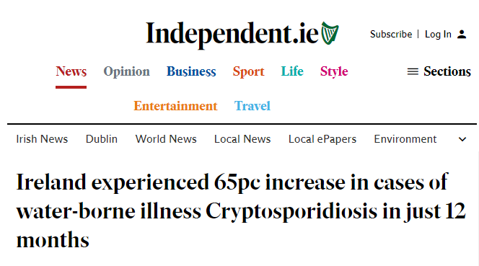
Why is good quality water in rivers lakes and groundwater so important?
Freshwater ecosystems provide a service for us - humans need clean water sources for drinking and other uses.
Some pollutants and contaminants in water may make it very difficult and expensive to treat/clean for human consumption.
To sustain freshwater biodiversity, many species need really good quality water.
Agriculture and food production needs clean water.
Some industries need very clean water.
Ireland’s Reputation – reports of water pollution, fish kills, drinking water contamination can damage our reputation as a producer of high-quality food and as a nation who care for their environment.
Source: Irish Independent, Oct 11, 2022

Slide 6
What determines water quality in our rivers, streams,
lakes, seas?
Oxygen levels
pH
Nutrient levels (e.g. N, P)
Presence /absence of toxic pollutants, e.g. pesticides
Amounts of suspended silt
If these factors are good, then the animal and plant communities in the river or lake will be healthy and thriving.
Ecological Status
The condition of the plant and animal communities in the river or lake.

Slide 7
How is Ecological Status described or ‘classified’?
Ecological Status
This classification comes from:
High
High
Good
EU Water Framework Directive
Moderate
Poor
Bad
The EU WFD Directive requires that all EU countries achieve Good Status for their surface water (lakes, rivers and coastal areas) and groundwater by 2027 and that they prevent deterioration happening in all water bodies.
Notes:
The Water Framework Directive (‘the Directive’) was adopted by member states across Europe in 2000. It requires, in summary terms, that all waters (rivers, lakes, groundwater, estuaries, coastal water, canals and reservoirs) are protected and that measures are put in place to ensure quality of these waters is restored to at least ‘good’ status or good potential (with some narrow exceptions) by 2027 at the latest. The Directive governs all activities that may have an impact on this objective or on the quality or quantity of water. The Directive requires an integrated approach (i.e. across all sectors including agriculture, industry, spatial policy etc.) to the sustainable management and protection of water resources. It impacts on, and is equally impacted by, a diverse range of environmental plans and regulations. The River Basin Management Plan sets out the measures necessary to protect and improve the quality of our waters (See Appendix 1 for elements to be covered in river basin management plans as per Annex VIII of the Directive). These plans are prepared in 6-year cycles, during which a programme of measures must be implemented so as to achieve water quality objectives. Good water quality contributes to protecting human health by improving the quality of drinking water sources and bathing waters.

Slide 8
Water Framework Directive (WFD)
River Basin Management Plan
EU Water Framework Directive was adopted in 2000. Each EU member state must set out a plan to achieve the aims of the WFD.
Irelands 2nd River Basin Management Plan 2018-2021.
The 3rd RBMP for the period 2022-2027 is being drafted.
Have they succeeded so far?
No. Deadlines for achieving the objectives keep getting extended. The first deadline was 2015, the latest is 2027.
It’s a difficult problem!

Slide 9
What do we need to monitor* in a waterbody
to determine its ecological status ?
Rivers, streams & lakes
Ecological Status
Biological factors
High
Invertebrates (Q value- rivers only) (Chapter 4)
Phytoplankton, aquatic plants, fish (lakes only)
Nutrients (N, P,), O₂, pH
Toxic chemicals
Hydromorphology
Good
Moderate
Poor
Chemical & Physical factors
Bad
* Monitor = check and test repeatedly

Slide 10
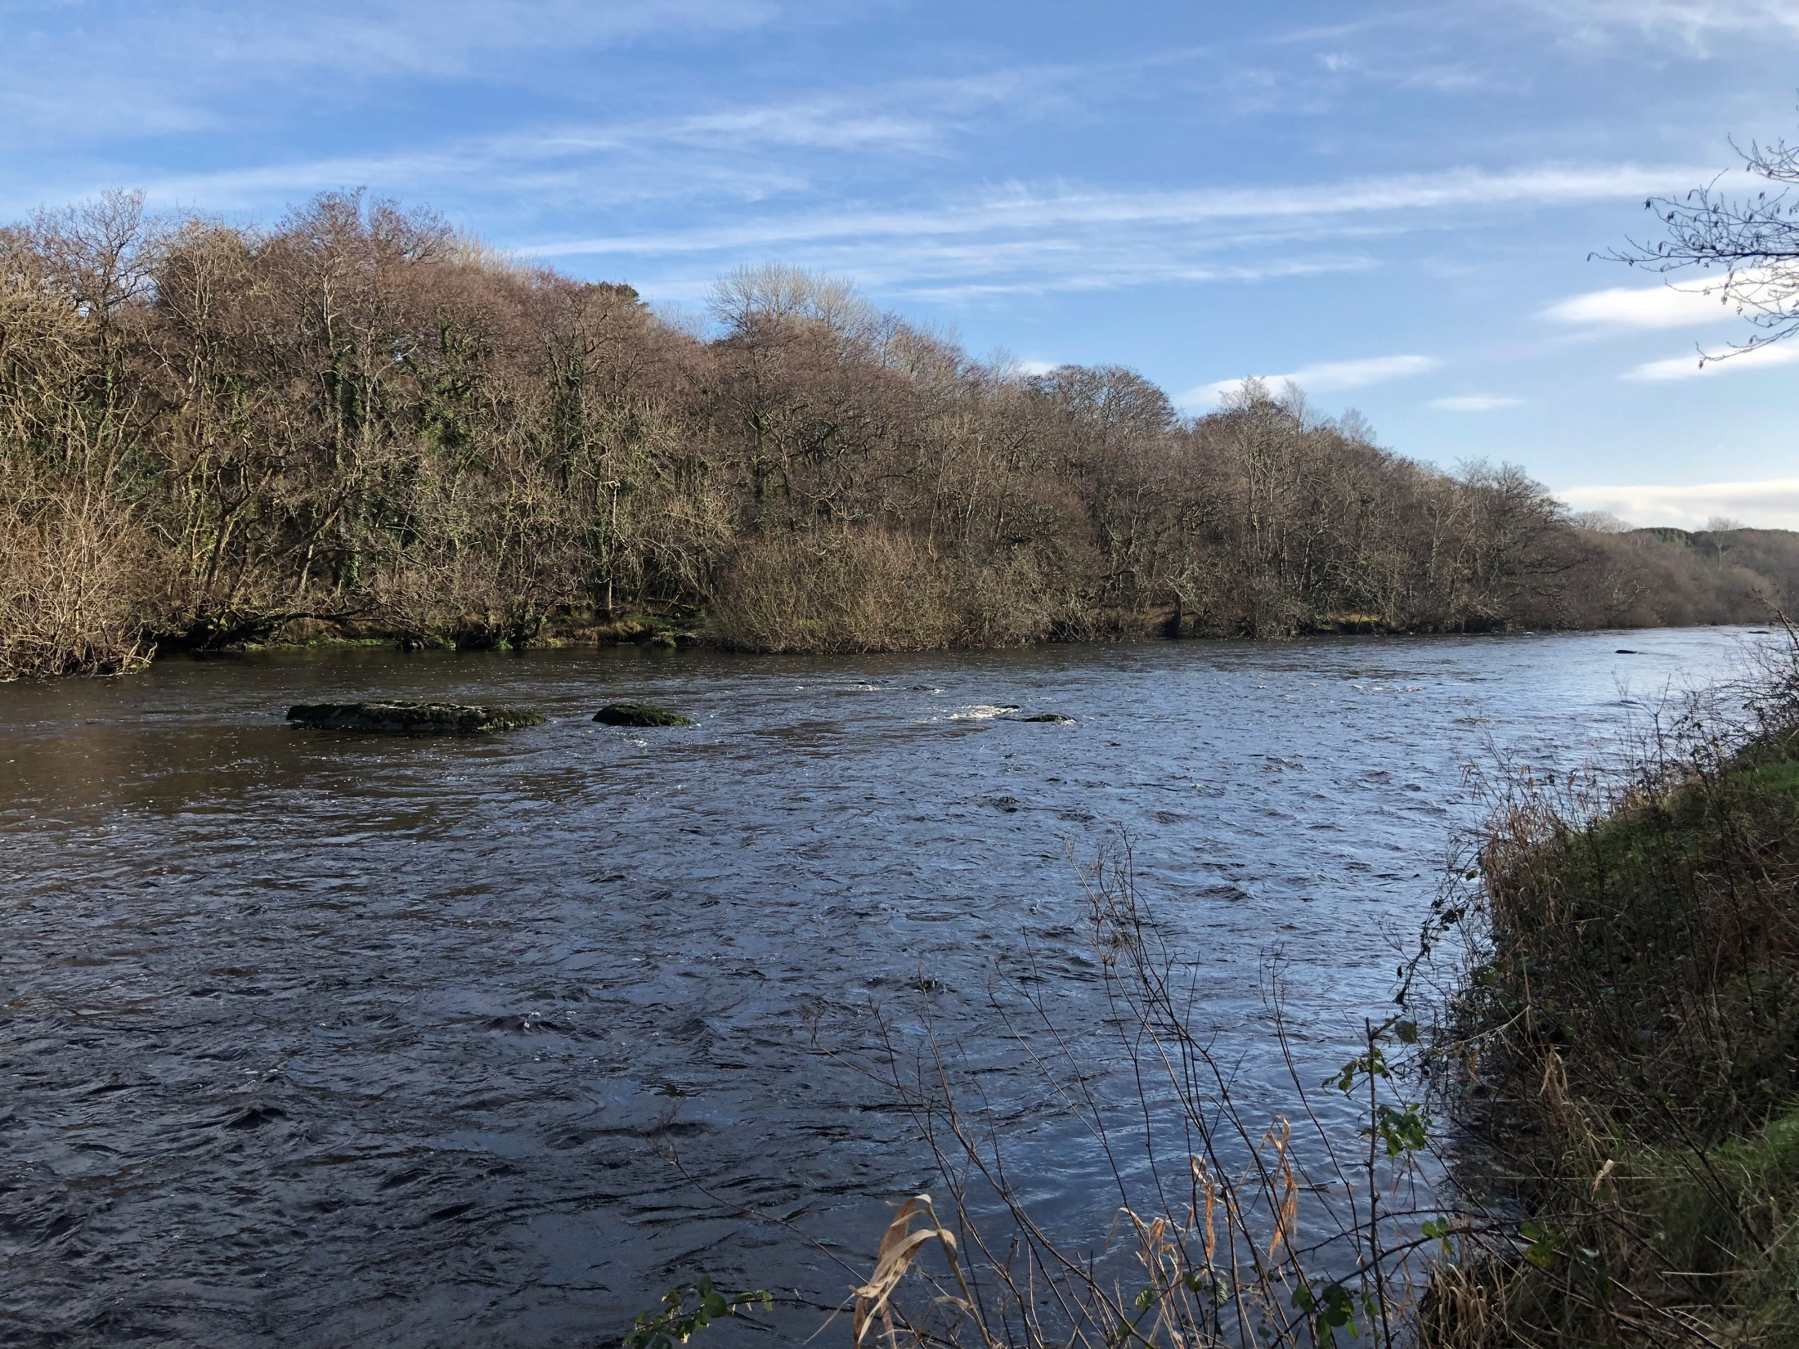
Determining the ecological status of
rivers vs. lakes each needs different methods
In rivers, determining the Q value is the most valuable measure of ecological status
At a number of river site or ‘stations’ on the river, the macro-invertebrates such as insects, crustaceans, mites, snails, mussels, leeches, and worms are examined by kick-sampling. Recall that macroinvertebrates are indicators of water quality. If stoneflies, flathead mayflies and other invertebrates are present in high numbers it indicates a Q value of 4 or 5 and therefore Good or High ecological status.
Q Value | Pollution Status | Ecological Status
Q5, Q4-5 | Unpolluted | High
Q4 | Unpolluted | Good
Q3-4 | Slightly Polluted | Moderate
Q3, Q2-3 | Moderately Polluted | Poor
Q2,Q1-2 | Seriously Polluted | Bad
Notes:
River Monitoring
“Ireland has over 84,800km of river channel with streams, rivers and tributaries flowing from their headwaters through a network of channels that reaches almost every community and townland in the country. Ireland’s national water quality monitoring programme is designed to provide representative information on our entire river network through the monitoring of discrete sections of river called water bodies. There are 3,192 river water bodies delineated in Ireland and 2,401 (75%) of these are monitored as part of the national river monitoring programme.
Summary for Rivers
1,603 (just over 50%) of river water bodies are in high or good ecological status and 1,589 (almost 50%) are in moderate, poor or bad ecological status.
There has been a 1% decline in the number of monitored river water bodies in satisfactory condition since the 2013-2018 period.
319 rivers have a High Status Objective, which was set under the River Basin Management Plan 2018-2021, and only 43% have achieved this.
Nearly one fifth (18.5%) of monitored river water bodies are in poor or bad status and are severely polluted.
Over the period of this assessment there were 161 fish kills recorded.
43% of rivers sites have high nitrate concentrations and 39% of sites have increasing concentrations, mostly in the south and southeast of the country.
30% of river sites have high phosphorus concentrations and 17% of sites have increasing concentrations.”
Adapted fromWater Quality in Ireland 2016–2021. EPA 2022. https://www.epa.ie/publications/monitoring--assessment/freshwater--marine/Water-Quality-in-Ireland-2016-2021-Report.pdf

Slide 11
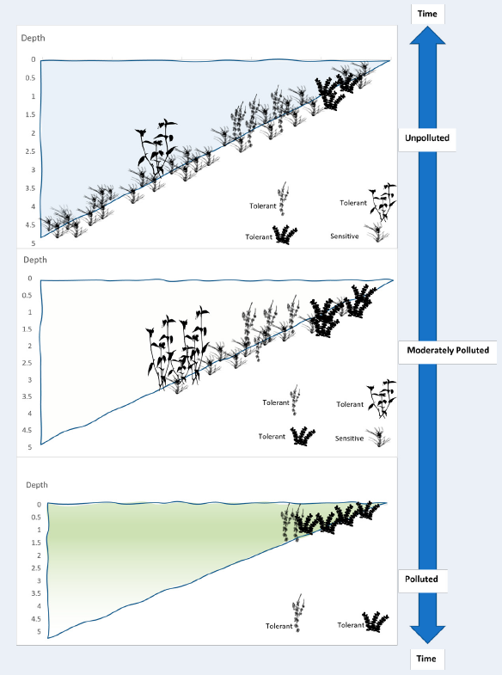
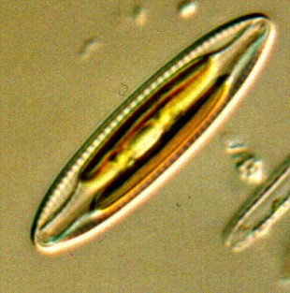
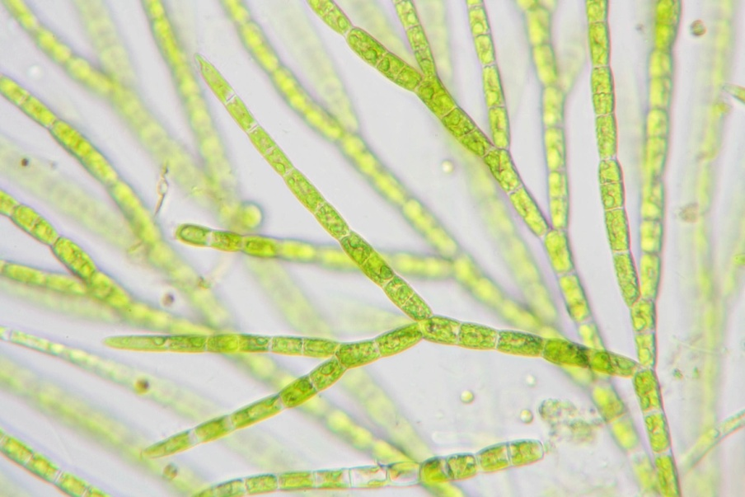
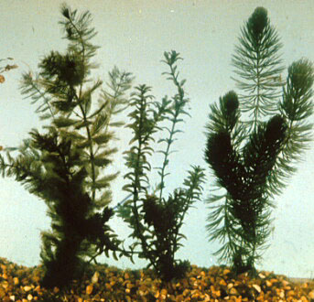
Q assessment is not applied
to lakes.
Instead, ecological status is based on a wider range of bio-indicators
Depth
Unpolluted
Phytoplankton (microscopic algae)
Diatoms (type of alga)
Aquatic plants
Invertebrates
Fish
Moderately polluted
Green alga
Polluted
Diatom
(type of alga)
Hornwort (aquatic plant)
Notes:
Source: https://www.epa.ie/publications/monitoring--assessment/freshwater--marine/water-quality-in-2022-indicator-report.php
Image source: Caroline Plant, EPA

Slide 12
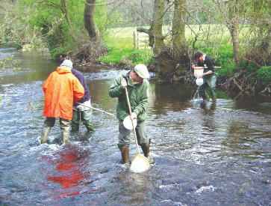
Water Quality sampling in rivers
Watch this video to illustrate a kick sample and macro-invertebrates Magic of Water - Ecological Wonder - YouTube
The previous two slides and the video describes what is known as biological monitoring and it is the most used method for assessing ecological status in rivers and lakes.
But…. Physio-chemical and chemical monitoring is also used on a limited number of rivers and lakes.

Slide 13
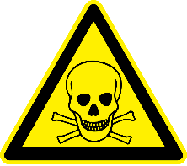
Physio-chemical monitoring measures
Nutrients dissolved in water
pH
Oxygen
Toxic chemicals
The main nutrients are nitrogen (N) and phosphorus (P). They have a big influence on ecological status. Too much of these can cause nutrient pollution and reduce ecological status.
A measure of acidity (<7) / alkalinity (>7). Increases in acidity can have a big impact on life in rivers and lakes. This a form of pollution known as acidification.
The amount of O₂ dissolved in water is a good indicator of how clean the water is. However, O₂ levels can vary a lot, so rather than measure O₂ directly, invertebrate bio-indicators can give a much better idea of O₂ levels in water.
These include chemicals that would never be found naturally in surface waters, for example pesticides like cypermethrin, an insecticide used in agriculture and forestry.

Slide 14
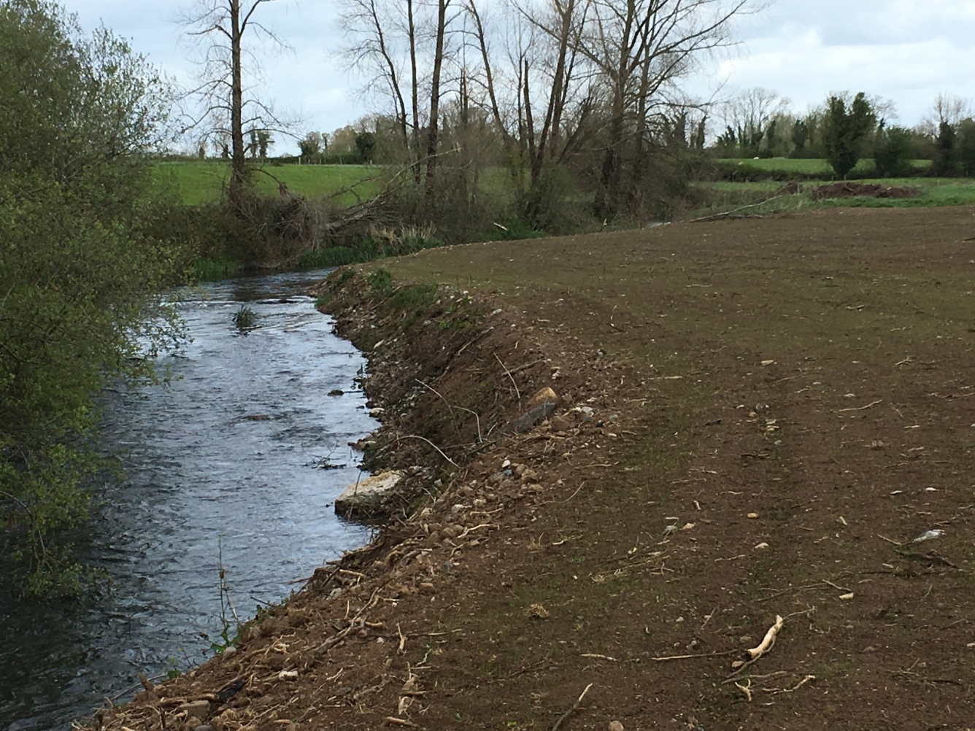
Hydromorphology
Refers to the shape (morphology) of the river or lake.
Is it still natural or has it been modified by drainage or other activities?
Are there barriers on the river that prevent fish migration?
Is important in determining the ecological status of a river.
In this river the bank has been highly modified.
The bankside vegetation has been stripped away and the natural slope of the banks has been made steeper, leaving it prone to erosion and increasing run-off of nutrients and sediment in the water

Slide 15
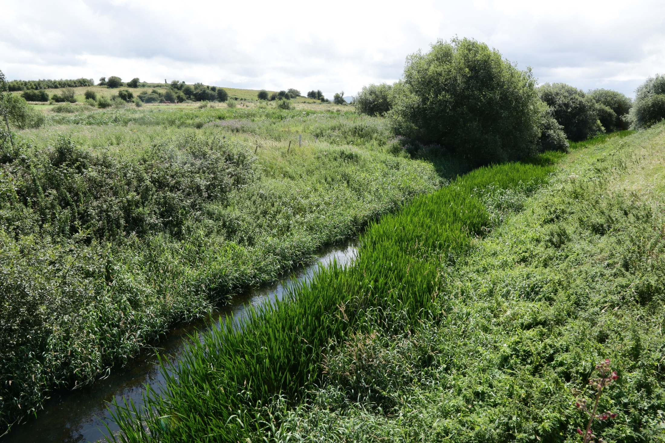
This river was modified by arterial drainage to improve drainage of the agricultural land along its banks: - the bed of the river was dug out and widened-very steep banks now. It has an unnatural cross-section
Course of the river was straightened
Water level is much shallower and the river is silting up.
The river is slowly reversing the changes made to it, so it needs constant maintenance
The hydromorphology of this river is ‘Poor’

Slide 16
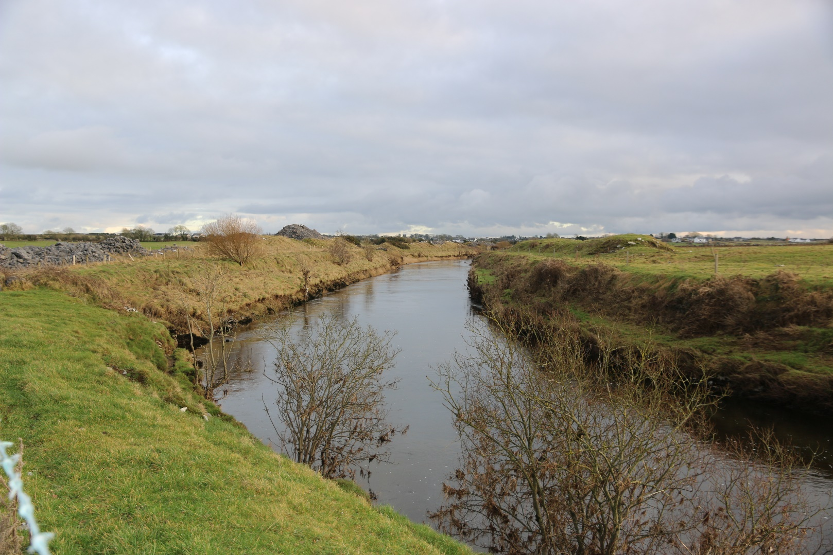
Hydromophology is not considered in drained rivers when assessing ecological status.
It is only applied to those rivers that have not been drained and have the potential to be assigned High Ecological Status.
Why?
Practically and politically it may be impossible to restore drained rivers to their original state
However, Inland Fisheries Ireland, local groups and angling clubs do a lot to restore river habitats
Notes:
Many Irish rivers particularly in low-lying agricultural areas were drained in the last century to improve agricultural land (arterial drainage as opposed to land drainage). As a result they have poor hydromorphology-they lack many of the features of a natural river, pools rapids, gravel areas for spawning salmon and trout, natural riparian vegetation etc. Some are more like canals than rivers and some are disfigured by rock piles dredged from the bed of the river to lower the level. In early arterial drainage schemes, little or no consideration was given to ecological concerns but later schemes did make some efforts to address these. The office of Public Works was empowered to carry out these schemes under the 1945 Drainage Act, and are obliged to routinely maintain the rivers in this condition. In recent decades however the OPW and Inland Fisheries Ireland (IFI) have collaborated in devising more ecologically sympathetic maintenance protocols and in restoring fish habitat (re-creating pools, faster water, spawning beds). There has been much criticisms of the Drainage Act and the powers it confers on the OPW, and much clamour for its repeal. It is unlikely however that there will be any large-scale efforts to redress the ecological damage caused by early Arterial Drainage schemes given the likely political opposition and economic cost.
Because so many rivers have less than good hydromorpology as a reult of arterial drainage, and there is little likelihood of this changing, hydromophology is not considered a criterion in these river for deciding ecological status. It is applied to those rivers that have not been drained and have the potential to be assigned High ecological status.
Photo credit: Thomas Harrington, Maigue Rivers Trust

Slide 17
Who Does the Water Quality Monitoring in Ireland?
coordinates the water monitoring program, analyses the data and produces reports.
Five other agencies are involved in collecting data and monitoring:
Local Authorities, e.g.
Inland Fisheries Ireland
Office of Public Works
Marine Institute
Waterways Ireland
Notes:
Ireland has more than 73,000 km of river channels. If placed end-to-end, they could encircle the Earth almost twice. Three-quarters of these channels are very small streams that typically flow into larger rivers.
Biological monitoring has been carried out in Irish rivers since 1971. The current national river monitoring programme covers more than 13,000 km of river channel.
https://www.epa.ie/publications/monitoring--assessment/freshwater--marine/EPA_WFD_MonitoringProgramme_2019_2021-(1).pdf

Slide 18
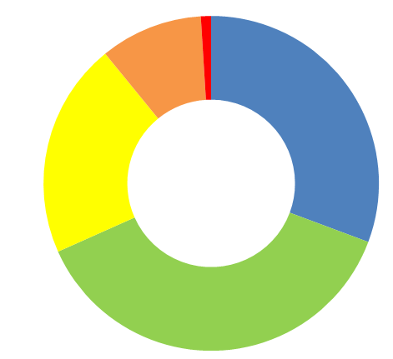
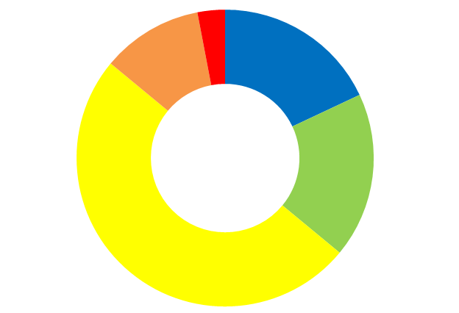
The Ecological Status of our Surface Waters now (2023)
Bear in mind that all are required to be in Good or High status by 2027
Ecological Status
0.1%
High
1%
8%
Good
18%
10%
Moderate
31%
Rivers
42%
Poor
21%
Lakes
Bad
Lakes
32%
3%
11%
18%
38%
Estuaries
18%
50%

Slide 19
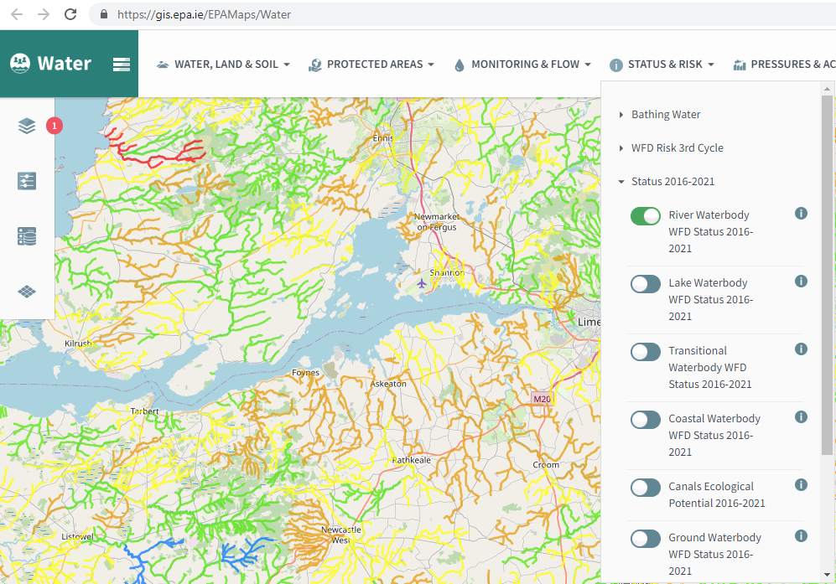
Task 1.1
Find the Ecological Status and Q values for your local river
Go to www.catchments.ie
Click on ‘Maps’
Zoom in to focus on your local area
Select ‘Water’
(may automatically be selected)
Select ‘STATUS & RISK’
Select ‘Status 2016-2021’
Then slide ‘River Waterbody WFD status 2013-2018’ to green
WFD = Water Framework Directive

Slide 20
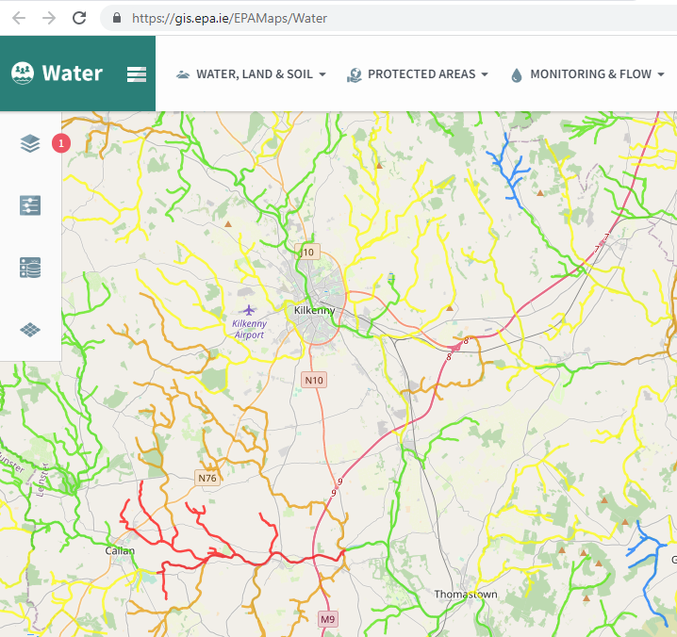
Task 1.1
River Waterbody WFD Status 2016-2021
An example of the rivers around Kilkenny city shows rivers with ecological status ranging from
High
to
Bad .
High status (blue), Good status (Green) are not polluted
Yellow is moderately polluted
Brown is poor status
Red is Bad and very polluted

Slide 21
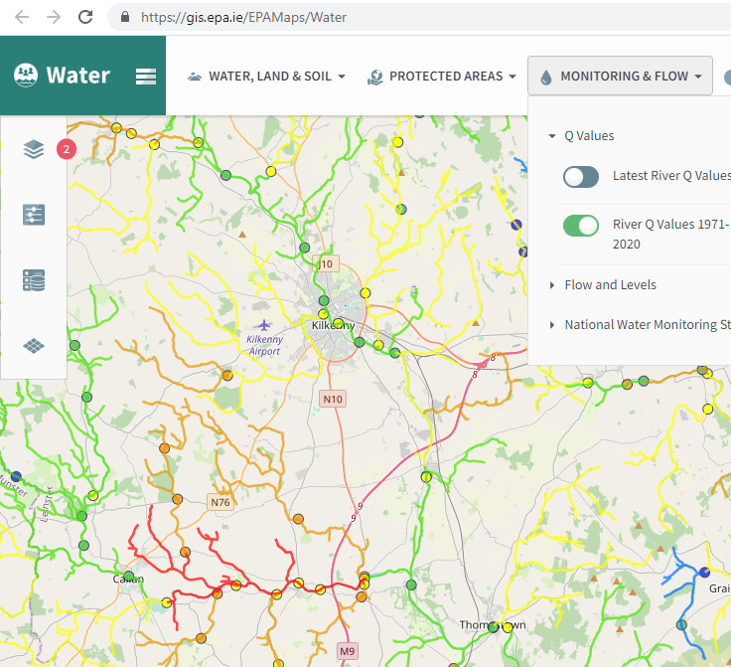
Task 1.1
Click on ‘MONITORING & FLOW’
and slide ‘River Q values 1971-2020 to green.
This shows the sites on rivers that are routinely sampled for
Q values
Frequently, the ecological status of a river stretch is worse than the Q values would suggest. This is because there are other factors that decide the status that are not so good.

Slide 22
Summary
Water quality is a measure of how clean the water is, and whether it is suitable for drinking, a healthy living environment for fish and river life, farming, swimming, etc.
The water quality of Irish rivers, lakes, estuaries and coastal areas is in decline.
Freshwater ecosystems provides us humans with clean water sources for drinking and other uses.
Water quality is determined by Oxygen levels, pH, Nutrient levels, the absence of toxic pollutants and amount of suspended silt.
If these factors are good then the animal and plant communities will be healthy – bio-indicators.
We can determine water quality - the Q value - by the presence or absence of bio-indicators.
Hydromorphology – the shape of rivers - has a big impact on ecological status.

