Slide 1
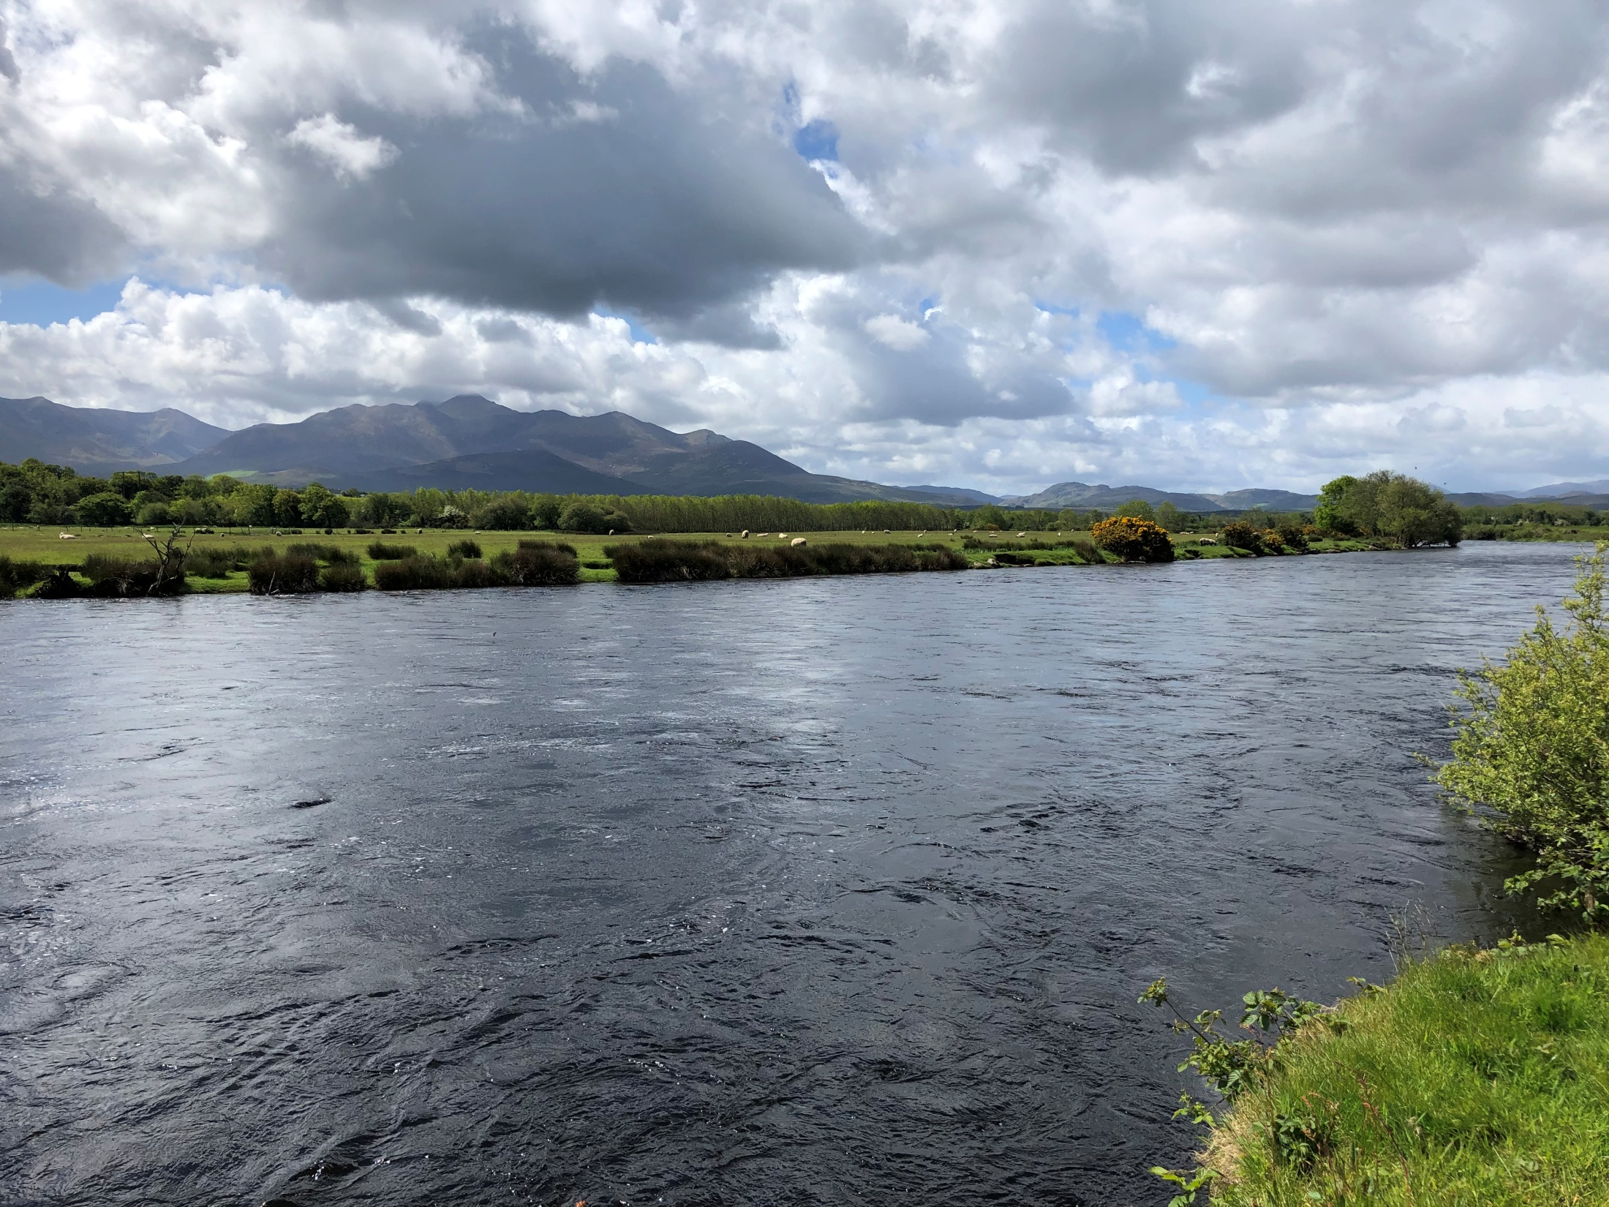
Freshwater Biodiversity and Habitats
Lesson 2. Invertebrate Life as Bio-indicators

Slide 2
Nature Needs Good Water Quality
Water quality describes the condition of the water, according to chemical, physical, and biological characteristics.
In the same way humans need clean water so too does nature.
Some invertebrates can only survive in very good water conditions.
Over the next few slides, you will learn about these species and how we can use their presence or absence to tell us more about water quality.

Slide 3
Using invertebrates
to determine water quality
Stoneflies
The EPA and County Council scientists use a method based on the kinds of invertebrates present in a river to determine the water quality.
This is called the Quality Rating or ‘Q System’
Mayflies
Caddisflies
Freshwater Shrimp
Snails
Q Value | Water Quality
Q5, Q4-5 | Unpolluted
Q4 | Unpolluted
Q3-4 | Slightly Polluted
Q3, Q2-3 | Moderately Polluted
Q2,Q1-2 | Seriously Polluted
Water louse
Bloodworms

Slide 4
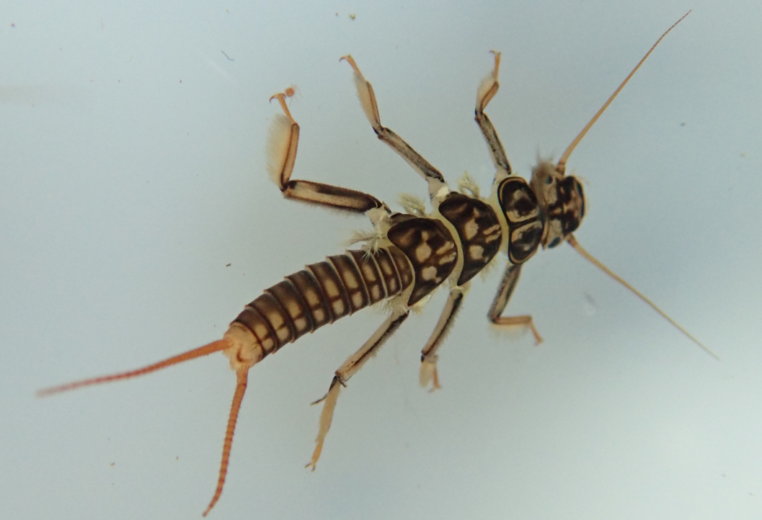
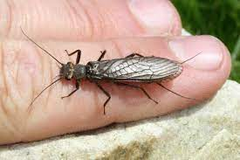
Clean Water Fauna (animals)
Stoneflies
Insect family (3 pairs of legs)
20 different species in Ireland
They have 2 tails
Lives in fast-flowing water for 1-2 years. Most graze algae but some species are predators.
Stoneflies need lots of oxygen and generally live in faster-flowing water
Stonefly - Juvenile stage
They eventually hatch into a flying adult.
Their wings lie flat over their body.
If the river is polluted by a pollutant that removes oxygen, they will die.
If you find stoneflies in a river, it means the water quality is very good - a good bio-indicator of high water quality.
Stonefly - Adult stage
Notes:
The EPA and local authorities use a method based on the kinds of invertebrates present in a river to determine the water quality. This is called the Quality Rating or ‘Q System’
The Q value of a river site is assessed by kick sampling. The surveyor places a hand-held net in a shallow riffle part of the river and disturbs the bed of the river just upstream of the net by kicking. This dislodges the invertebrates, which are then caught in the net. The sample of invertebrates are decanted into a tray and sorted and identified. If there are a lot of species that require clean water –the ‘clean water fauna’ (mayflies stoneflies and some caddis flies) - the sample will get a high score –Q4 or possibly Q5. If however, the clean water fauna is reduced or absent, and replaced by species that can tolerate polluted conditions, then the sample will be scored lower, possibly even as low as Q 1 if only very pollution-tolerant organisms are present

Slide 5
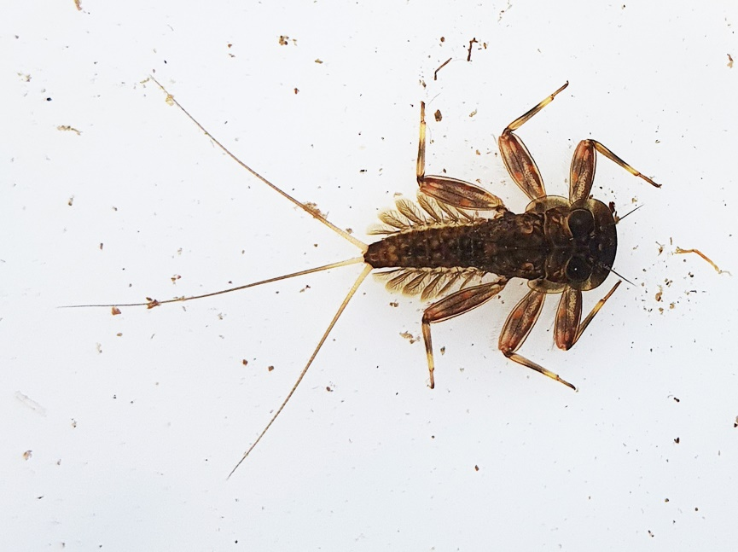
Clean Water Fauna
Mayflies
Insect
33 different species in Ireland.
Note the 3 tails and gills on the side of the body.
Juvenile stage-lives in the river for 1-2 years.
Grazes on algae and plants.
Juvenile flathead mayfly
Adult mayfly
Some mayflies need lots of oxygen and live in faster-flowing water like the flathead mayflies. These are indicators of good water quality, i.e. bio-indicators.
Others are not as fussy and be found in lightly polluted water.
Hatches into a flying short-lived adult. Wings held upright like a sail.
Notes:
Image source: Liz Gabbett, Maigue Rivers Trust.
Different mayfly species

Slide 6
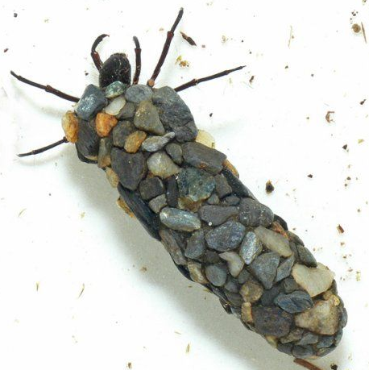
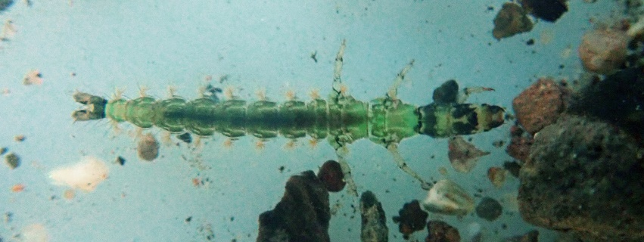
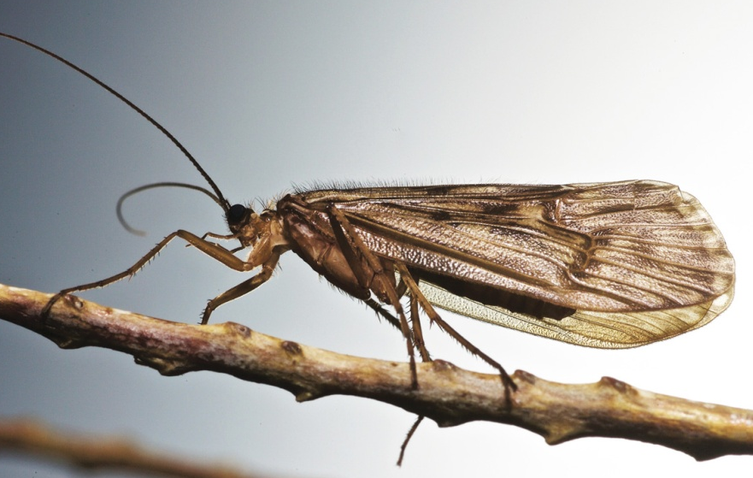
Clean Water Fauna
Caddisflies
Insect
156 different species in Ireland
These are predators of other invertebrates
Some build cases of stones or plant material as camouflage.
Others are caseless.
Some spin a web like spiders to catch prey
Cased caddis
Caseless caddis
The caddis larva hatches into a flying adult that looks like a moth. Wings folded over the body like a tent.
The adults are also known as
‘sedge flies’
Caddis are very diverse. Some require good water quality, others are less demanding.

Slide 7
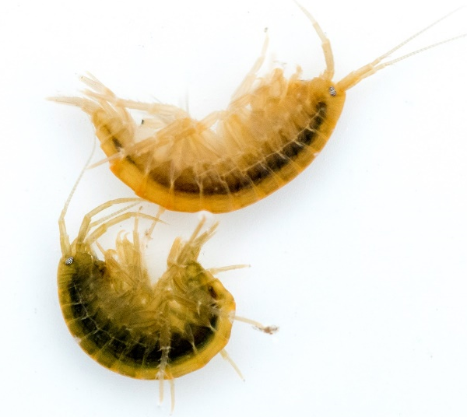
Polluted Water Fauna
Freshwater shrimps
Crustaceans
Note-lots of legs and body segments!
Shrimps can live in clean or even heavily polluted water.
Snails
Molluscs
They are herbivores and are important as food for fish.
Some types require clean water, while other types are less demanding
If these are present and the clean water fauna are reduced or absent, it means the water is polluted.

Slide 8
Polluted Water Fauna
Water Louse (Asellus)
Crustacean
Are an aquatic type of woodlouse
They are scavengers and can tolerate the very low oxygen levels found in polluted rivers and lakes .
If you find a lot them, you know the water is polluted.
Bloodworm or chironomid
These are not worms but are the larvae of an insect.
Hatch into a small fly, like a mosquito.
Red because they contain haemoglobin (usually not found in insects). This allows them to live in water that has very little oxygen.
If you find a lot them, you know the water is polluted.
Task 2.1

Slide 9
Using invertebrates
to determine water quality
Stoneflies
The EPA and County Council scientists use a method based on the kinds of invertebrates present in a river to determine the water quality.
This is called the Quality Rating or ‘Q System’
Mayflies
Caddisflies
Freshwater Shrimp
Snails
Q Value | Water Quality
Q5, Q4-5 | Unpolluted
Q4 | Unpolluted
Q3-4 | Slightly Polluted
Q3, Q2-3 | Moderately Polluted
Q2,Q1-2 | Seriously Polluted
Water louse
Bloodworms

Slide 10
Pollution of rivers is most frequently caused by organic matter on nutrient such as nitrogen and phosphorus. These pollutants reduce the amount of oxygen in the water.
Organic Matter, N, P
Stoneflies
Mayflies
Caddisflies
Freshwater Shrimp
When oxygen levels in a river are reduced by pollution, the clean water fauna are replaced through competition with organisms that are better suited to lower oxygen levels.
Snails
Water louse
Bloodworms
O₂

Slide 11
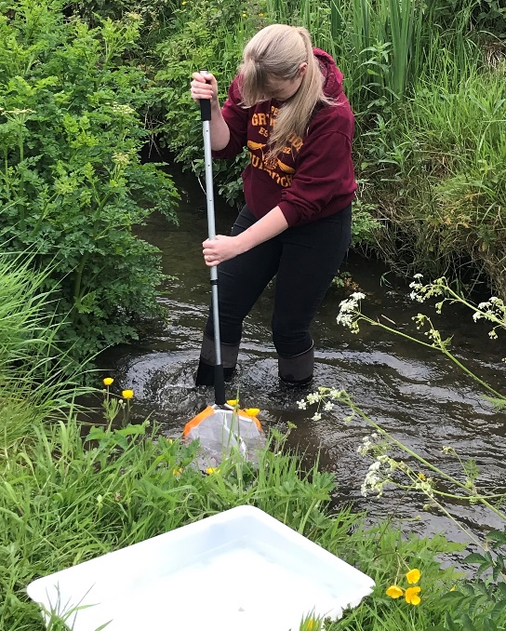
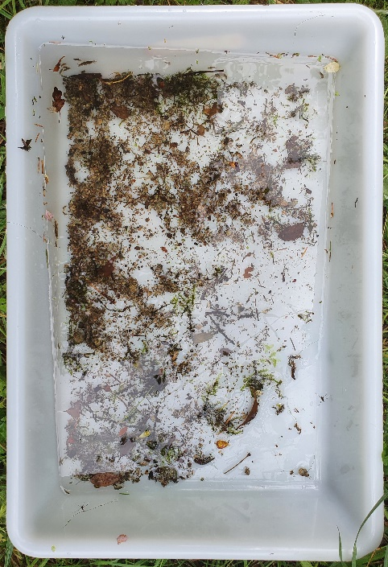
How do find the water quality or Q value of a river?
Kick sampling!
A surveyor places a hand-held net in a shallow riffle part of the river and disturbs the bed of the river just upstream of the net by kicking.
This dislodges the invertebrates, which are then caught in the net.
These are then transferred into a tray and sorted and identified.
If there are a lot of species that require clean water –the ‘clean water fauna’ (mayflies, stoneflies and some caddis flies) - the sample will get a high score – Q4 or possibly Q5.
If however, the clean water fauna is reduced or absent, and replaced by species that can tolerate polluted conditions, then the sample will be scored lower, possibly even as low as Q1 if only very pollution-tolerant organisms are present.

Slide 12
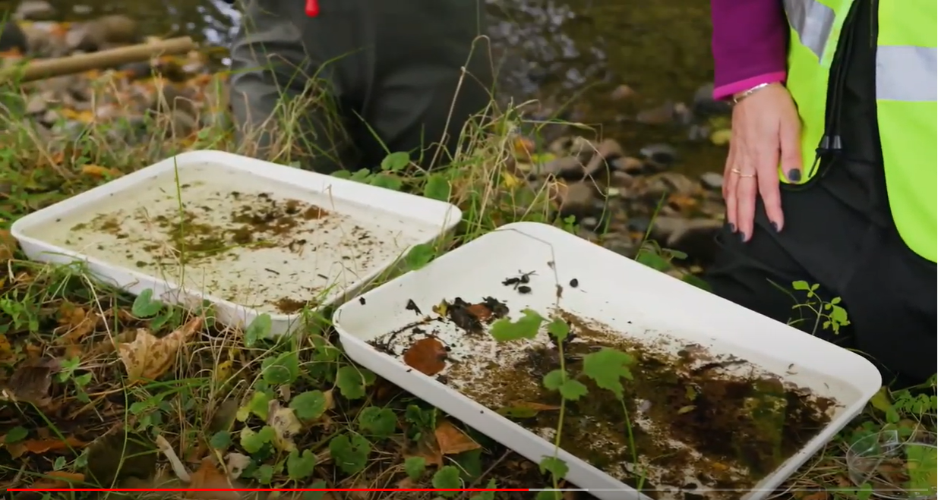
Magic of Water – Ecological Wonder
Task 2.2
https://www.youtube.com/watch?v=DphFA-i27XY (3:15min – 7:37min)

Slide 13
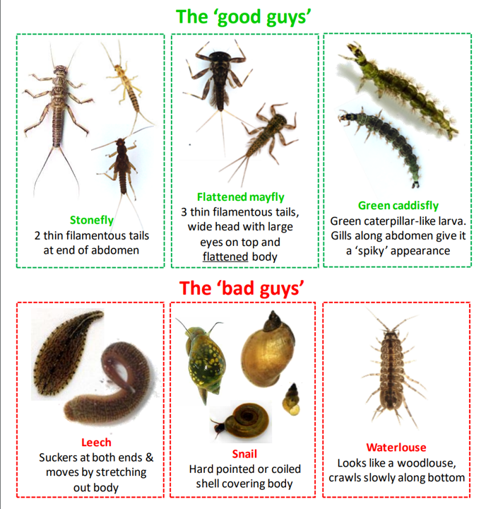
Water quality monitoring
Water quality in rivers and lakes is monitored across the country by the EPA and local authorities using the Q system. Monitoring started in the 1980s so monitoring gives a picture of how water quality has changed over time.
Local communities and environmental groups also monitor water quality through ‘Citizen Science’.
They use a simplified version of Q System based on the ‘Good Guys’ and the ‘Bad Guys’*.
Citizen science monitoring increases the information about water quality, especially in small streams that the EPA or councils do not monitor
The small streams are really important for biodiversity and salmon spawning.
* Properly known as the Citizen Science Stream Index (CSSI)
Notes:
Water quality in rivers and lakes is tracked or monitored across the country by the EPA and local authorities using the Q system. For example in Limerick there are over 70 locations on rivers that are assessed at once every 3 years. Monitoring started in the 1980s so monitoring gives a picture of how water quality has changed over time.
Local communities and environmental groups also monitor water quality. This is called in ‘Citizen Science’. They use a simplified version of Q System based on the ‘Good Guys’ and the ‘Bad Guys’*.

Slide 14
Task 2.3
Notes:
These sheets are what citizen scientists record their results on.

Slide 15
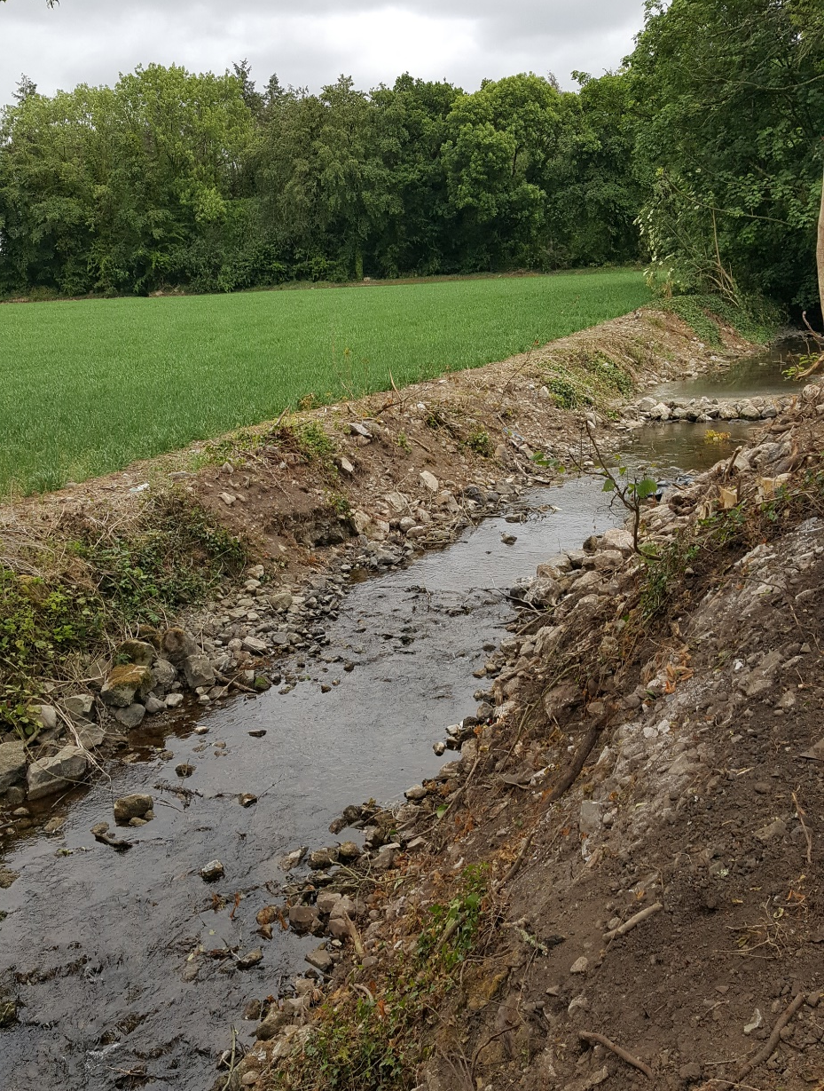
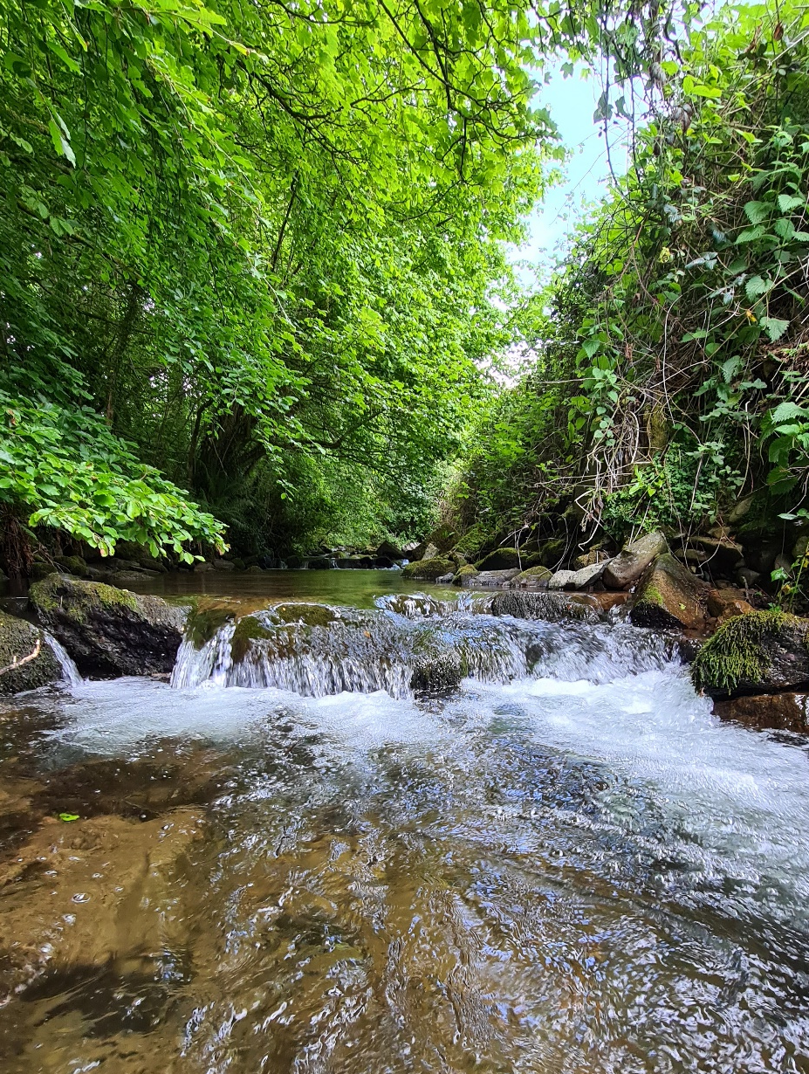
River A
River B
Which river is likely to have the greatest diversity of invertebrates?

Slide 16
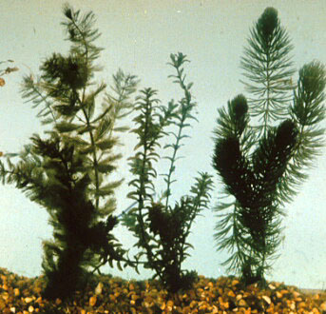
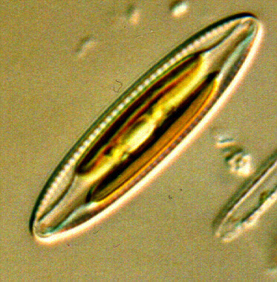
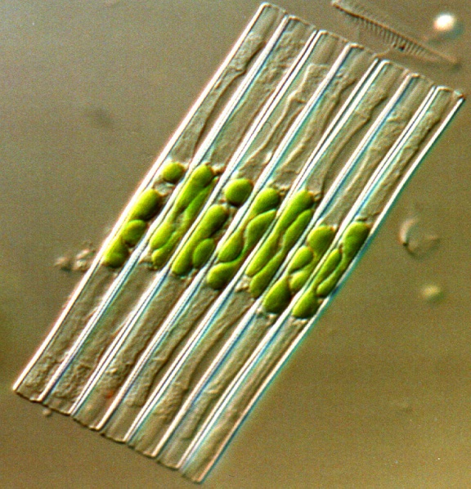
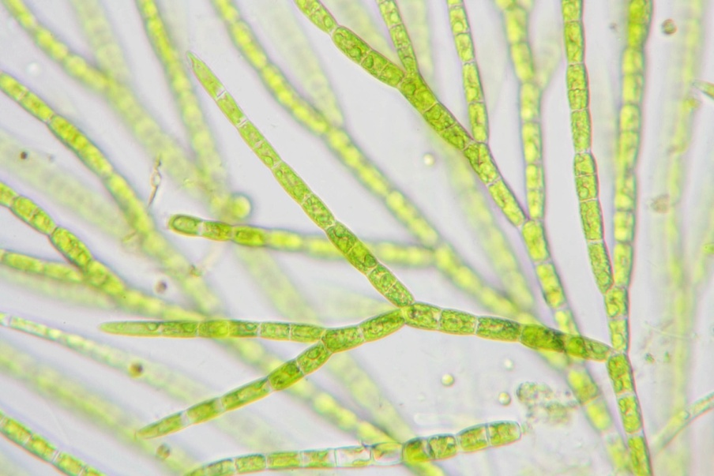
Remember
The plant life in a river or lake is the foundation of the food chain
Aquatic plants are not only food but also habitat for macroinvertebrates.
BUT there needs to be balance of the right amount and type of plants for a healthy river system.
Hornwort (aquatic plant)
Diatom (type of alga)
Diatom (type of alga)
Green alga

